Slide 1



IBM Websphere DataStage Enterprise Edition
Parallel Jobs
Limited Brands - October 2006
© 2004 Capgemini - All rights reserved
May 04 – Remote Configuration, Himanshu Gupta

Slide 2
Parallel Jobs Training Agenda
DataStage Essentials
Introduction to DataStage Enterprise Edition
Advanced PX
© 2004 Capgemini - All rights reserved
May 04 – Remote Configuration, Himanshu Gupta

Slide 3
Using the Course Material
Suggestions for learning
  Take notes
  Review previous material
  Practice
  Learn from errors
© 2004 Capgemini - All rights reserved
May 04 – Remote Configuration, Himanshu Gupta

Slide 4
DataStage Essentials
© 2004 Capgemini - All rights reserved
May 04 – Remote Configuration, Himanshu Gupta

Slide 5
Introduction Part1
Introduction to DataStage
© 2004 Capgemini - All rights reserved
May 04 – Remote Configuration, Himanshu Gupta

Slide 6
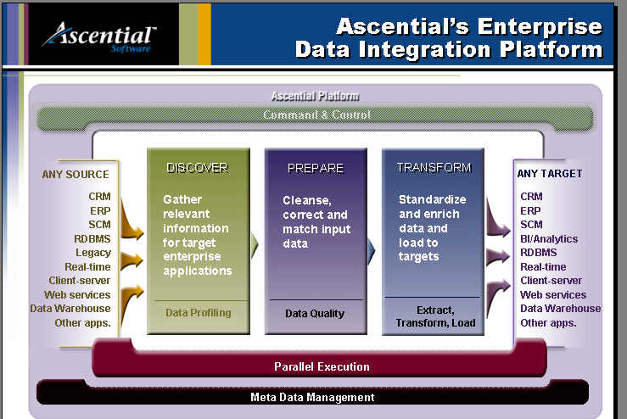
Ascential Platform
© 2004 Capgemini - All rights reserved
May 04 – Remote Configuration, Himanshu Gupta
Notes:
Ascential Software looked at what’s required across the whole lifecycle to solve enterprise data integration problems not just once for an individual project, but for multiple projects connecting any type of source (ERP, SCM, CRM, legacy systems, flat files, external data, etc) with any type of target.
Ascential’s uniqueness comes from the combination of proven best-in-class functionality, across data profiling, data quality and matching, and ETL combined to provide a complete end-to-end data integration solution on a platform with unlimited scalability and performance through parallelization. We can therefore deal not only with gigabytes of data, but terabytes of data, and petabytes of data - data volumes becoming more and more common………., and do so with complete management and integration of all the meta data in the enterprise environment.
This is indeed an end-to-end solution, which customers can implement in whatever phases they choose, and which, by virtue of its completeness and breadth and robustness of solution, helps our customers get the quickest possible time to value and time to impact from strategic applications. It assures good data is being fed into the informational systems and that our solution provides the ROI and economic benefit customers expect from investments in strategic applications, which are very large investments and, which done right, should command very large returns.

Slide 7
What is DataStage?
DataStage is a comprehensive tool for the fast, easy creation and maintenance of data marts and data warehouses. It provides the tools you need to build, manage, and expand them. With DataStage, you can build solutions faster and give users access to the data and reports they need.
Design jobs for Extraction, Transformation, and Loading (ETL)
Ideal tool for data integration projects – such as, data warehouses, data marts, and system migrations
Import, export, create, and managed metadata for use within jobs
Schedule, run, and monitor jobs all within DataStage
Administer your DataStage development and execution environments
© 2004 Capgemini - All rights reserved
May 04 – Remote Configuration, Himanshu Gupta

Slide 8
Introduction to DataStage
Ascential (Now IBM WebSphere) DataStage is an ETL tool
  Extract
    Extract data from any source: Database, Sequential files, Programs via Named pipes.
    If functionality is not available by default, plug-in stages are either available or can be created in C++ or Java(Using Java PACK).
    Ascential also provides Special sets of Plug-in stages called PACK’s (Packaged Application Connectivity Kits) to interface with major Application Systems like SAP, JD Edwards, PeopleSoft Enterprise, Seibel.
  Transform
    Data can transformed, sorted, calculations performed and cleansed as per required business rules.
    Thanks to the Parallel nature of operation, the Speed of operation and the volume of records process is limited only by the Hardware Configuration.
    Custom functionality not present can be provided by coding Custom Stages (Build-Ops) in C++ or Java.
  Load
    Like Extract, the target data can be loaded in any system. Apart from the above, facilities also exist for performing FTP and sending Email.
© 2004 Capgemini - All rights reserved
May 04 – Remote Configuration, Himanshu Gupta

Slide 9
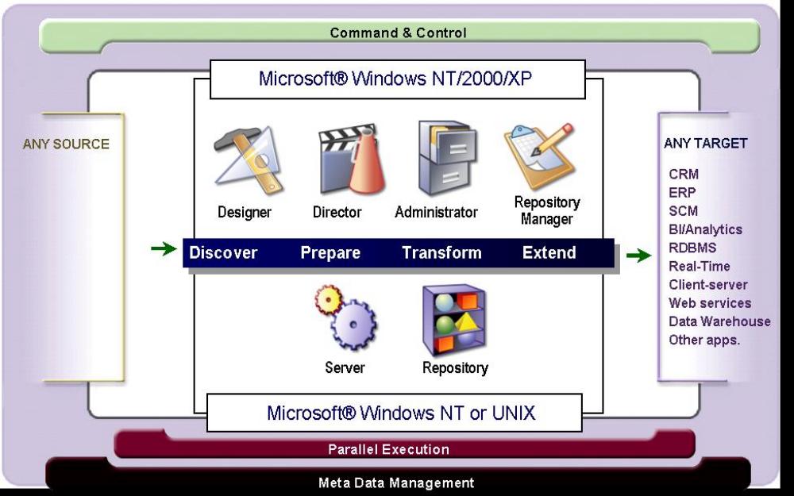
DataStage Server and Clients
© 2004 Capgemini - All rights reserved
May 04 – Remote Configuration, Himanshu Gupta

Slide 10
DataStage Server and Clients – contd..
The DataStage client components are:
Administrator: Administers DataStage projects and conducts housekeeping on the server
Designer: Creates DataStage jobs that are compiled into executable programs
Director: Used to Run, Monitor and Schedule the DataStage jobs
Manager: Allows you to view and edit the contents of the repository
© 2004 Capgemini - All rights reserved
May 04 – Remote Configuration, Himanshu Gupta

Slide 11
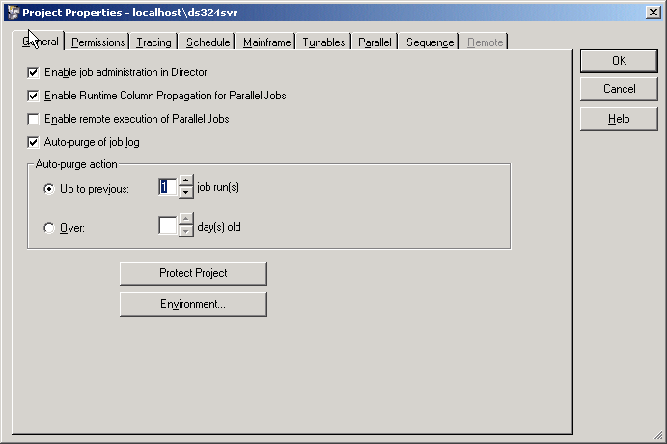
DataStage Administrator
© 2004 Capgemini - All rights reserved
May 04 – Remote Configuration, Himanshu Gupta
Notes:
Use the Administrator to specify general server defaults, add and delete projects, and to set project properties. The Administrator also provides a command interface to the UniVerse repository.
Use the Administrator Project Properties window to:
· Set job monitoring limits and other Director defaults on the General tab.
· Set user group privileges on the Permissions tab.
· Enable or disable server-side tracing on the Tracing tab.
· Specify a user name and password for scheduling jobs on the Schedule tab.
· Specify hashed file stage read and write cache sizes on the Tunables tab.

Slide 12
DataStage Administrator – contd..
Use the Administrator to specify general server defaults, add and delete projects, and to set project properties. The Administrator also provides a command interface to the UniVerse repository.
Use the Administrator Project Properties window to:
Set job monitoring limits and other Director defaults on the General tab.
Set user group privileges on the Permissions tab.
Enable or disable server-side tracing on the Tracing tab.
Specify a user name and password for scheduling jobs on the Schedule tab.
Specify hashed file stage read and write cache sizes on the Tunables tab.
© 2004 Capgemini - All rights reserved
May 04 – Remote Configuration, Himanshu Gupta

Slide 13
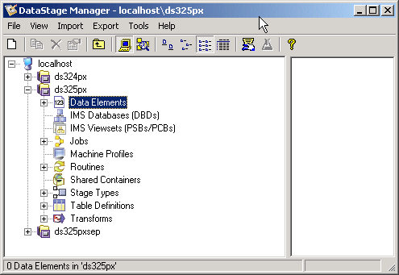
DataStage Manager
© 2004 Capgemini - All rights reserved
May 04 – Remote Configuration, Himanshu Gupta
Notes:
Use the Manager to store and manage reusable metadata for the jobs you define in the Designer. This metadata includes table and file layouts and routines for transforming extracted data.
Manager is also the primary interface to the DataStage repository. In addition to table and file layouts, it displays the routines, transforms, and jobs that are defined in the project. Custom routines and transforms can also be created in Manager.

Slide 14
DataStage Manager – contd..
Use the Manager to store and manage reusable metadata for the jobs you define in the Designer. This metadata includes table and file layouts and routines for transforming extracted data.
Manager is also the primary interface to the DataStage repository. In addition to table and file layouts, it displays the routines, transforms, and jobs that are defined in the project.
Custom routines and transforms can also be created in Manager.
© 2004 Capgemini - All rights reserved
May 04 – Remote Configuration, Himanshu Gupta

Slide 15
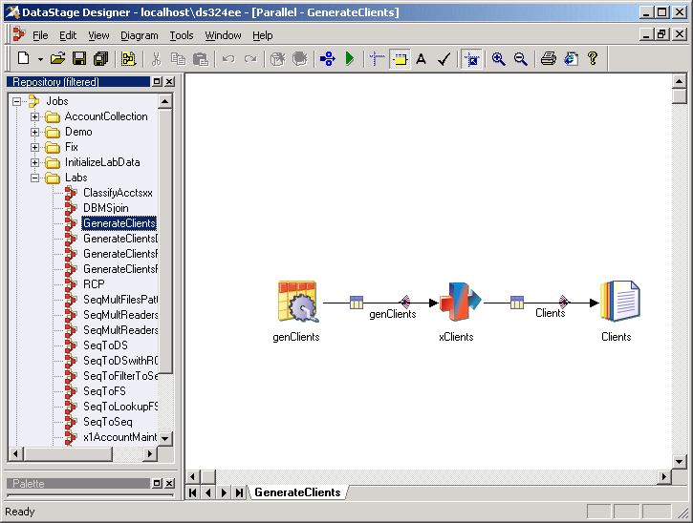
DataStage Designer
© 2004 Capgemini - All rights reserved
May 04 – Remote Configuration, Himanshu Gupta
Notes:
The DataStage Designer allows you to use familiar graphical point-and-click techniques to develop processes for extracting, cleansing, transforming, integrating and loading data into warehouse tables.
The Designer provides a “visual data flow” method to easily interconnect and configure reusable components.

Slide 16
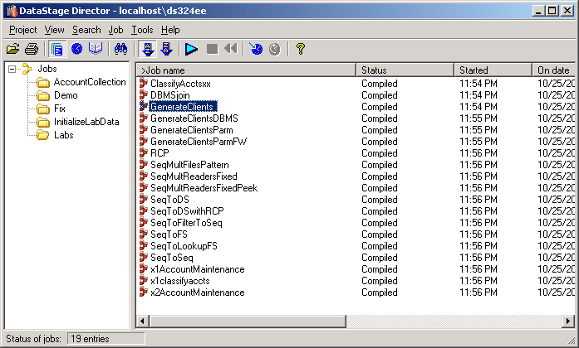
DataStage Director
Use the Director to validate, run, schedule, and monitor your DataStage jobs. You can also gather statistics as the job runs.
© 2004 Capgemini - All rights reserved
May 04 – Remote Configuration, Himanshu Gupta

Slide 17
DataStage Projects
All your work is done in a DataStage project. Before you can do anything, other than some general administration, you must open (attach to) a project.
Projects are created during and after the installation process. You can add projects after installation on the Projects tab of Administrator.
A project is associated with a directory. The project directory is used by DataStage to store your jobs and other DataStage objects and metadata.
You must open (attach to) a project before you can do any work in it.
Projects are self-contained. Although multiple projects can be open at the same time, they are separate environments. You can, however, import and export objects between them.
Multiple users can be working in the same project at the same time. However, DataStage will prevent multiple users from accessing the same job at the same time.
© 2004 Capgemini - All rights reserved
May 04 – Remote Configuration, Himanshu Gupta

Slide 18
Developing in DataStage
Server
Repository
Projects
Stages
DS Jobs
Job Sequence
Data Elements (Metadata – Table Definitions)
© 2004 Capgemini - All rights reserved
May 04 – Remote Configuration, Himanshu Gupta

Slide 19
Developing Job in DataStage
Define global and project properties in Administrator
Import metadata into Manager
Build job in Designer
Compile Job in Designer
Validate, run, and monitor Job Run in Director
© 2004 Capgemini - All rights reserved
May 04 – Remote Configuration, Himanshu Gupta

Slide 20
Quiz– True or False
DataStage Designer is used to build and compile your ETL jobs
Manager is used to execute your jobs after you build them
Director is used to execute your jobs after you build them
Administrator is used to set global and project properties
© 2004 Capgemini - All rights reserved
May 04 – Remote Configuration, Himanshu Gupta

Slide 21
Introduction Part 2
Configuring Projects And the DataStage Administrator
© 2004 Capgemini - All rights reserved
May 04 – Remote Configuration, Himanshu Gupta

Slide 22
Module Objectives
After this module you will be able to:
  Explain how to create and delete projects
  Set project properties in Administrator
  Set EE global properties in Administrator
© 2004 Capgemini - All rights reserved
May 04 – Remote Configuration, Himanshu Gupta

Slide 23
Project Properties
Projects can be created and deleted in Administrator
Project properties and defaults are set in Administrator
© 2004 Capgemini - All rights reserved
May 04 – Remote Configuration, Himanshu Gupta

Slide 24
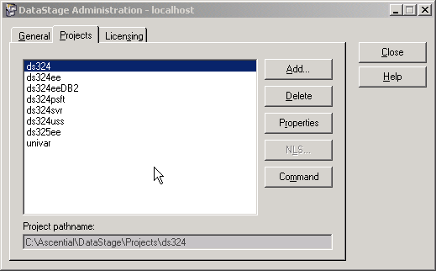
Setting Project Properties
To set project properties, log onto Administrator, select your project, and then click “Properties” to open the Project Properties window
© 2004 Capgemini - All rights reserved
May 04 – Remote Configuration, Himanshu Gupta
Notes:
The logon screen for Administrator does not provide the option to select a specific project (unlike the other DataStage clients).

Slide 25
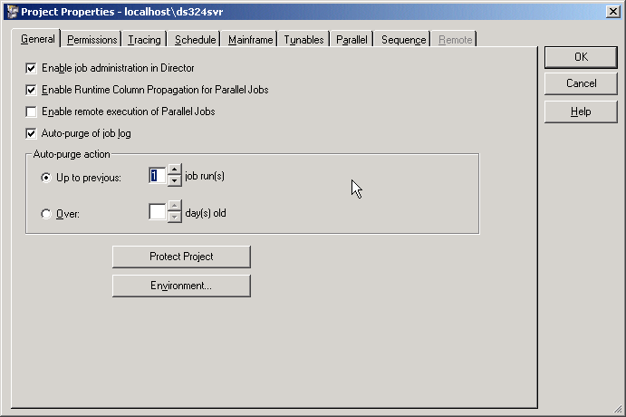
Projects General Tab
There are nine tabs. (The Mainframe tab is only enabled if your license supports mainframe jobs.) The default is the General tab.
© 2004 Capgemini - All rights reserved
May 04 – Remote Configuration, Himanshu Gupta
Notes:
If you select the Enable job administration in Director box, you can perform some administrative functions in Director without opening Administrator.
When a job is run in Director, events are logged describing the progress of the job. For example, events are logged when a job starts, when it stops, and when it aborts. The number of logged events can grow very large. The Auto-purge of job log box tab allows you to specify conditions for purging these events.
You can limit the logged events either by number of days or number of job runs.

Slide 26
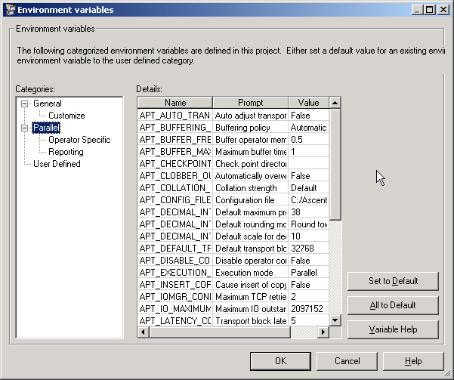
Environment Variables
Environment Variables are like Global Parameters.
© 2004 Capgemini - All rights reserved
May 04 – Remote Configuration, Himanshu Gupta

Slide 27
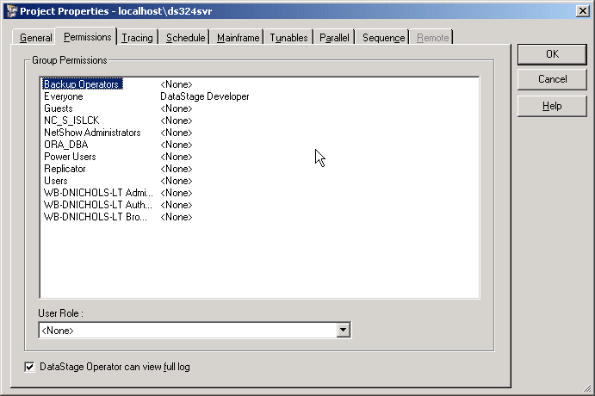
Permissions Tab
Use this page to set user group permissions for accessing and using DataStage. All DataStage users must belong to a recognized user role before they can log on to DataStage. This helps to prevent unauthorized access to DataStage projects.
© 2004 Capgemini - All rights reserved
May 04 – Remote Configuration, Himanshu Gupta
Notes:
Use this page to set user group permissions for accessing and using DataStage. All DataStage users must belong to a recognized user role before they can log on to DataStage. This helps to prevent unauthorized access to DataStage projects.
There are three roles of DataStage user:
· DataStage Developer, who has full access to all areas of a DataStage project.
· DataStage Operator, who can run and manage released DataStage jobs.
· <None>, who does not have permission to log on to DataStage.
UNIX note: In UNIX, the groups displayed are defined in /etc/group.

Slide 28
Tracing Tab
This tab is used to enable and disable server-side tracing.
The default is for server-side tracing to be disabled. When you enable it, information about server activity is recorded for any clients that subsequently attach to the project. This information is written to trace files. Users with in-depth knowledge of the system software can use it to help identify the cause of a client problem. If tracing is enabled, users receive a warning message whenever they invoke a DataStage client.
Warning: Tracing causes a lot of server system overhead. This should only be used to diagnose serious problems.
© 2004 Capgemini - All rights reserved
May 04 – Remote Configuration, Himanshu Gupta
Notes:
This tab is used to enable and disable server-side tracing.
The default is for server-side tracing to be disabled. When you enable it, information about server activity is recorded for any clients that subsequently attach to the project. This information is written to trace files. Users with in-depth knowledge of the system software can use it to help identify the cause of a client problem. If tracing is enabled, users receive a warning message whenever they invoke a DataStage client.
Warning: Tracing causes a lot of server system overhead. This should only be used to diagnose serious problems.

Slide 29
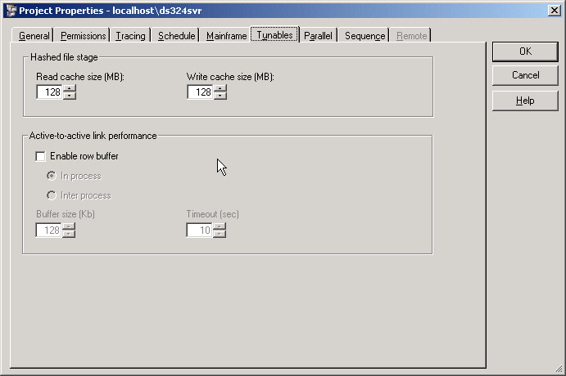
Tunables Tab
Tunables Tab is used to set certain properties of the HASH file (only available for Server Jobs)
© 2004 Capgemini - All rights reserved
May 04 – Remote Configuration, Himanshu Gupta
Notes:
On the Tunables tab, you can specify the sizes of the memory caches used when reading rows in hashed files and when writing rows to hashed files. Hashed files are mainly used for lookups and are discussed in a later module.

Slide 30
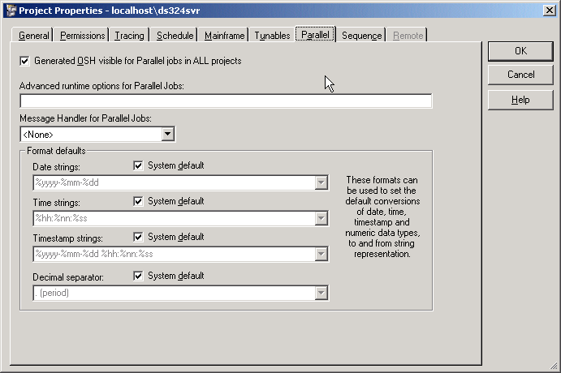
Parallel Tab
Here some of the properties specific to Parallel Jobs can be set
© 2004 Capgemini - All rights reserved
May 04 – Remote Configuration, Himanshu Gupta
Notes:
You should enable OSH for viewing – OSH is generated when you compile a job.

Slide 31
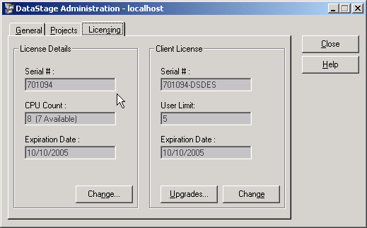
Licensing Tab
The Licensing Tab is used to change DataStage license information.
© 2004 Capgemini - All rights reserved
May 04 – Remote Configuration, Himanshu Gupta

Slide 32
Introduction Part 3
DataStage Manager and Meta Data Management
© 2004 Capgemini - All rights reserved
May 04 – Remote Configuration, Himanshu Gupta

Slide 33
Module Objectives
After this module you will be able to:
  Describe the DataStage Manager components and functionality
  Import and export DataStage objects
  Import metadata for a sequential file
© 2004 Capgemini - All rights reserved
May 04 – Remote Configuration, Himanshu Gupta

Slide 34
What Is Metadata?
Metadata is “data about data” - that describes the formats of sources and targets. This includes general format information such as whether the record columns are delimited and, if so, the delimiting character. It also includes the specific column definitions and data types.
© 2004 Capgemini - All rights reserved
May 04 – Remote Configuration, Himanshu Gupta

Slide 35
What Is Metadata? – Contd..
Data
Source
Target
Transform
Meta Data
Meta Data
Meta Data
Repository
© 2004 Capgemini - All rights reserved
May 04 – Remote Configuration, Himanshu Gupta

Slide 36
DataStage Manager
DataStage Manager is a graphical tool for managing the contents of your DataStage project repository, which contains metadata and other DataStage components.
Metadata describing sources and targets: Table definitions
DataStage objects: jobs, routines, table definitions, etc.
The left pane contains the project tree. There are seven main branches, but you can create subfolders under each. Select a folder in the project tree to display its contents.
© 2004 Capgemini - All rights reserved
May 04 – Remote Configuration, Himanshu Gupta
Notes:
DataStage Manager is a graphical tool for managing the contents of your DataStage project repository, which contains metadata and other DataStage components such as jobs and routines.
The left pane contains the project tree. There are seven main branches, but you can create subfolders under each. Select a folder in the project tree to display its contents.

Slide 37
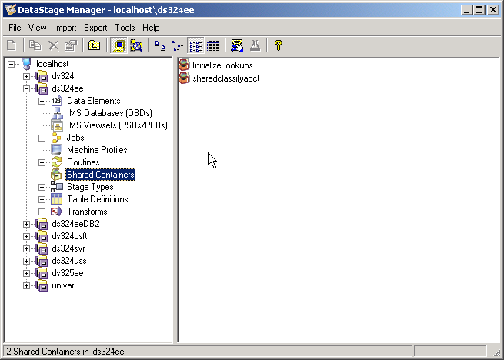
DataStage Manager – Contd..
© 2004 Capgemini - All rights reserved
May 04 – Remote Configuration, Himanshu Gupta

Slide 38
Manager Contents
DataStage Manager manages two different types of objects:
Metadata describing sources and targets: Called table definitions in Manager. These are not to be confused with relational tables. DataStage table definitions are used to describe the format and column definitions of any type of source: sequential, relational, hashed file, etc.
  Table definitions can be created in Manager or Designer and they can also be imported from the sources or targets they describe.
DataStage components: Every object in DataStage (jobs, routines, table definitions, etc.) is stored in the DataStage repository. Manager is the interface to this repository.
  DataStage components, including whole projects, can be exported from and imported into Manager.
© 2004 Capgemini - All rights reserved
May 04 – Remote Configuration, Himanshu Gupta

Slide 39
Import and Export
Any object in Manager can be exported to a file (XML or DSX)
This export file can then be imported back into DataStage
Import and Export can be used for many purposes:
Export whole projects
Backing up jobs and projects
Sometimes used for version control - Maintaining different versions of a job or project
Moving DataStage objects from one project to another or across different Servers
Use to share DataStage jobs and projects with other developers - The export files, when zipped, are small and can be easily emailed from one developer to another.
© 2004 Capgemini - All rights reserved
May 04 – Remote Configuration, Himanshu Gupta
Notes:
Any set of DataStage objects, including whole projects, which are stored in the Manager Repository, can be exported to a file. This export file can then be imported back into DataStage.
Import and export can be used for many purposes, including:
· Backing up jobs and projects.
· Maintaining different versions of a job or project.
· Moving DataStage objects from one project to another. Just export the objects, move to the other project, then re-import them into the new project.
· Sharing jobs and projects between developers. The export files, when zipped, are small and can be easily emailed from one developer to another.

Slide 40
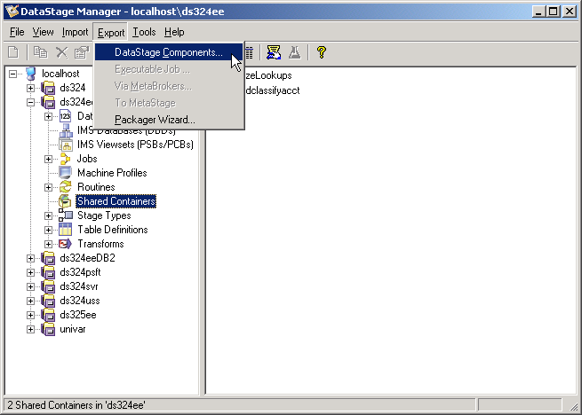
Exporting DataStage Objects
In Manager, click “Export>DataStage Components”
© 2004 Capgemini - All rights reserved
May 04 – Remote Configuration, Himanshu Gupta
Notes:
Click Export>DataStage Components in Manager to begin the export process.
Any object in Manager can be exported to a file. Use this procedure to backup your work or to move DataStage objects from one project to another.
Select the types of components to export. You can select either the whole project or select a portion of the objects in the project.
Specify the name and path of the file to export to. By default, objects are exported to a text file in a special format. By default, the extension is dsx. Alternatively, you can export the objects to an XML document.
The directory you export to is on the DataStage client, not the server.

Slide 41
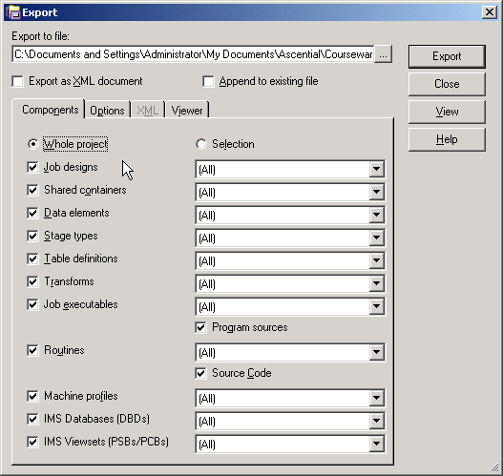
Exporting DataStage Objects – Contd..
Select DataStage objects for export
Specified type of export: DSX, XML
Specify file path on client machine
Click Export
© 2004 Capgemini - All rights reserved
May 04 – Remote Configuration, Himanshu Gupta

Slide 42
Quiz: True or False?
You can export DataStage objects such as jobs, but you can’t export metadata, such as field definitions of a sequential file.
The directory to which you export is on the DataStage client machine, not on the DataStage server machine.
© 2004 Capgemini - All rights reserved
May 04 – Remote Configuration, Himanshu Gupta

Slide 43
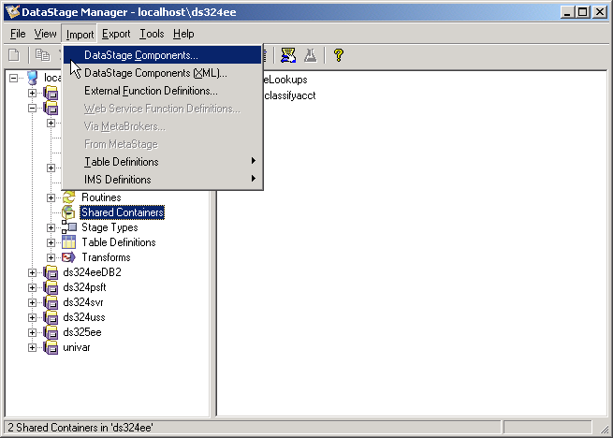
Importing DataStage Objects
In Manager, click “Import>DataStage Components”
© 2004 Capgemini - All rights reserved
May 04 – Remote Configuration, Himanshu Gupta
Notes:
To import DataStage components, click Import>DataStage Components.
Select the file to import. Click Import all to begin the import process or Import selected to view a list of the objects in the import file. You can import selected objects from the list. Select the Overwrite without query button to overwrite objects with the same name without warning.

Slide 44
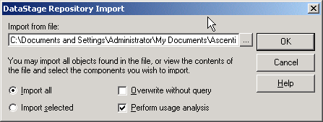
Importing DataStage Objects – Contd..
Select the DSX/XML file from which the Import has to be done
Click OK
© 2004 Capgemini - All rights reserved
May 04 – Remote Configuration, Himanshu Gupta
Notes:
To import DataStage components, click Import>DataStage Components.
Select the file to import. Click Import all to begin the import process or Import selected to view a list of the objects in the import file. You can import selected objects from the list. Select the Overwrite without query button to overwrite objects with the same name without warning.

Slide 45
Metadata Import
Import format and column destinations from sequential files
Import relational table column destinations
Imported as “Table Definitions”
Table definitions can be loaded into job stages
    Table definitions define the formats of a variety of data files and tables. These definitions can then be used and reused in your jobs to specify the formats of data stores.
Eg: You can import the format and column definitions of the Customers.txt file. You can then load this into the sequential source stage of a job that extracts data from the Customers.txt file.
You can load this same metadata into other stages that access data with the same format. In this sense the metadata is reusable. It can be used with any file or data store with the same format.
If the column definitions are similar to what you need you can modify the definitions and save the table definition under a new name.
© 2004 Capgemini - All rights reserved
May 04 – Remote Configuration, Himanshu Gupta
Notes:
Table definitions define the formats of a variety of data files and tables. These definitions can then be used and reused in your jobs to specify the formats of data stores.
For example, you can import the format and column definitions of the Customers.txt file. You can then load this into the sequential source stage of a job that extracts data from the Customers.txt file.
You can load this same metadata into other stages that access data with the same format. In this sense the metadata is reusable. It can be used with any file or data store with the same format.
If the column definitions are similar to what you need you can modify the definitions and save the table definition under a new name.
You can import and define several different kinds of table definitions including: Sequential files and ODBC data sources.

Slide 46
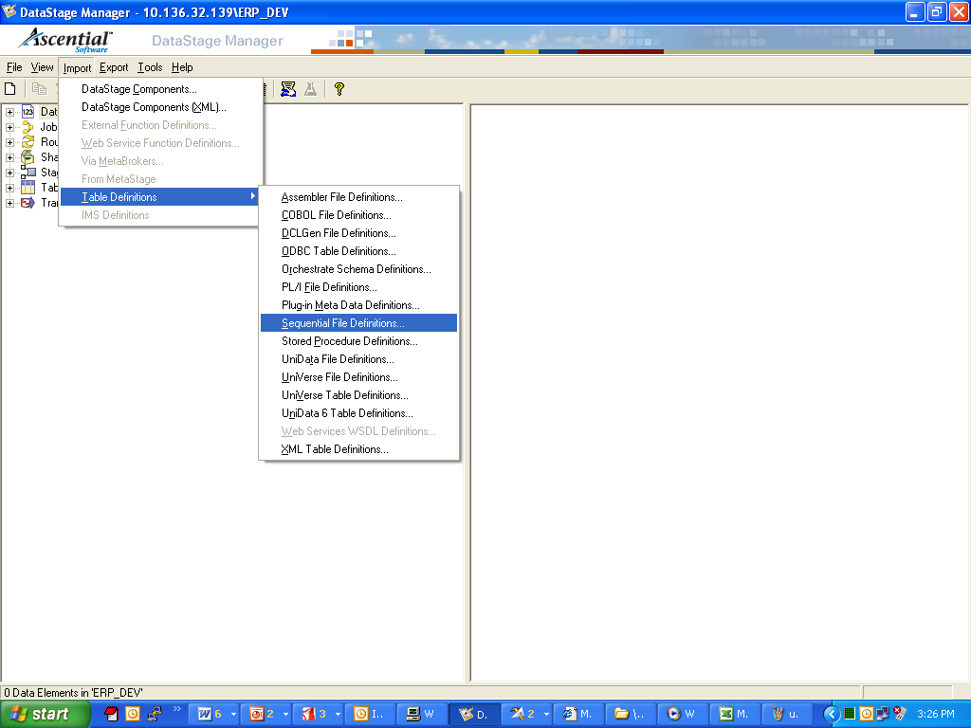
Table Definition Import Procedure
In Manager, click “Import>Table Definitions”
Depending on the source, choose Sequential/XML/ODBC/Plug-In
© 2004 Capgemini - All rights reserved
May 04 – Remote Configuration, Himanshu Gupta
Notes:
To start the import, click Import>Table Definitions>Sequential File Definitions. The Import Meta Data (Sequential) window is displayed.
Select the directory containing the sequential files. The Files box is then populated with the files you can import.
Select the file to import.
Select or specify a category (folder) to import into.
· The format is: <Category>\<Sub-category>
· <Category> is the first-level sub-folder under Table Definitions.
· <Sub-category> is (or becomes) a sub-folder under the type.

Slide 47
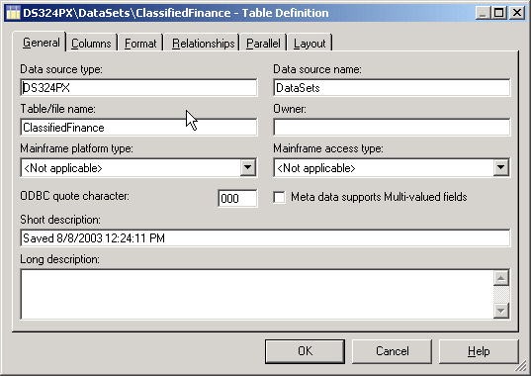
Table Definition Import Procedure – Contd..
Select directory containing sequential file and then the file (in case of sequential file metadata import)
Select Manager Category and SubCategory where it should be saved
© 2004 Capgemini - All rights reserved
May 04 – Remote Configuration, Himanshu Gupta

Slide 48
Exercise
© 2004 Capgemini - All rights reserved
May 04 – Remote Configuration, Himanshu Gupta

Slide 49
Introduction Part 4
DataStage Designer and Job Designing
© 2004 Capgemini - All rights reserved
May 04 – Remote Configuration, Himanshu Gupta

Slide 50
Module Objectives
After this module you will be able to:
  Describe what a DataStage job is
  List the steps involved in creating a job
  Describe links and stages
  Identify the different types of stages
  Design a simple extraction and load job
  Compile your job
  Create parameters to make your job flexible
  Document your job
© 2004 Capgemini - All rights reserved
May 04 – Remote Configuration, Himanshu Gupta

Slide 51
What Is a Job?
Executable DataStage program
Created in DataStage Designer, but can use components from Manager
Built using a graphical user interface
Compiles into Orchestrate shell language (OSH)
In DataStage, you can design and run jobs that perform many useful data
integration tasks, including data extraction, data conversion, data
aggregation, data loading, etc.
DataStage jobs are:
Designed and built in Designer.
Scheduled, invoked, and monitored in Director.
Executed under the control of DataStage.
© 2004 Capgemini - All rights reserved
May 04 – Remote Configuration, Himanshu Gupta
Notes:
A job is an executable DataStage program. In DataStage, you can design and run jobs that perform many useful data integration tasks, including data extraction, data conversion, data aggregation, data loading, etc.
DataStage jobs are:
· Designed and built in Designer.
· Scheduled, invoked, and monitored in Director.
· Executed under the control of DataStage.

Slide 52
Job Development Overview
In Manager, import metadata defining sources and targets
In Designer, add stages defining data extractions and loads
Add Transformers and other stages to define data transformations
Add links defining the flow of data from sources to targets
Compile the job
In Director, validate, run, and monitor your job
© 2004 Capgemini - All rights reserved
May 04 – Remote Configuration, Himanshu Gupta

Slide 53
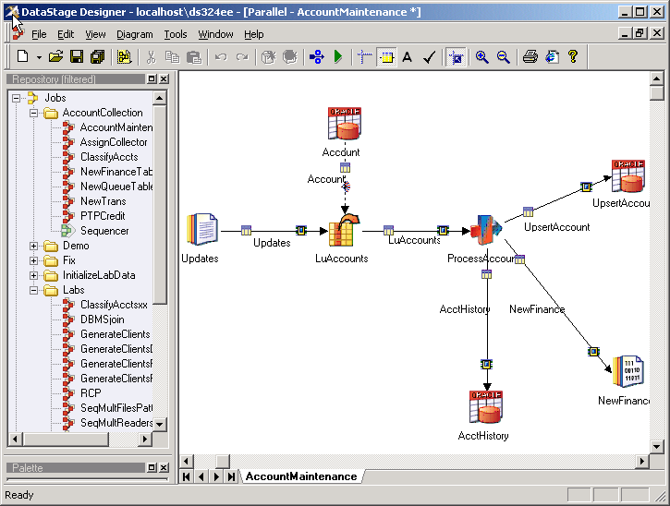
Designer Work Area
© 2004 Capgemini - All rights reserved
May 04 – Remote Configuration, Himanshu Gupta
Notes:
The appearance of the designer work space is configurable; the graphic shown here is only one example of how you might arrange components.
In the right center is the Designer canvas, where you create stages and links. On the left is the Repository window, which displays the branches in Manager. Items in Manager, such as jobs and table definitions can be dragged to the canvas area.
Click View>Repository to display the Repository window.

Slide 54
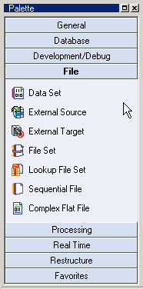
Tools Palette
The tool palette contains icons that represent the components one can add to any job design.
You can also install additional stages called plug-ins for special purposes.
© 2004 Capgemini - All rights reserved
May 04 – Remote Configuration, Himanshu Gupta
Notes:
The tool palette contains icons that represent the components you can add to your job design.
You can also install additional stages called plug-ins for special purposes.

Slide 55
Adding Stages and Links
Stages can be dragged from the tools palette or from the stage type branch of the repository view
Links can be drawn from the tools palette or by right clicking and dragging from one stage to another
Metadata or column definitions can be loaded into any of the Source or Target stages by clicking the “Load” option inside the Stage’s Output tab.
Metadata or column definitions can be saved into the repository from any of the stages, by clicking the “Save” option inside the Stage’s Output/Input tab.
© 2004 Capgemini - All rights reserved
May 04 – Remote Configuration, Himanshu Gupta

Slide 56
Job Creation Example
Brief walkthrough of procedure
Presumes meta data already loaded in repository
© 2004 Capgemini - All rights reserved
May 04 – Remote Configuration, Himanshu Gupta

Slide 57
Sequential File Stage
Used to extract data from, or load data to, a sequential file.
The main things you need to specify when using the sequential file
stage are the following:
Path and name of file (Source or Target)
File format (Fixed-width, delimited – comma, tab etc.)
Column definitions (meta data – column name, data type)
If the sequential stage is being used as a target, specify the write
action: Overwrite the existing file or append to it.
© 2004 Capgemini - All rights reserved
May 04 – Remote Configuration, Himanshu Gupta
Notes:
The Sequential stage is used to extract data from a sequential file or to load data into a sequential file.
The main things you need to specify when editing the sequential file stage are the following:
· Path and name of file
· File format
· Column definitions
· If the sequential stage is being used as a target, specify the write action: Overwrite the existing file or append to it.

Slide 58
Designer - Create New Job
Several types of DataStage jobs:
Server – not covered in this Training. However, you can create server jobs, convert them to a container, then use this container in a parallel job. However, this has negative performance implications.
Shared container (parallel or server) – contains reusable components that can be used by other jobs.
Mainframe – DataStage 390, which generates Cobol code
Parallel – This Training will concentrate on parallel jobs.
Job Sequence – used to create jobs that control execution of other jobs.
© 2004 Capgemini - All rights reserved
May 04 – Remote Configuration, Himanshu Gupta
Notes:
Several types of DataStage jobs:
Server – not covered in this course. However, you can create server jobs, convert them to a container, then use this container in a parallel job. However, this has negative performance implications.
Shared container (parallel or server) – contains reusable components that can be used by other jobs.
Mainframe – DataStage 390, which generates Cobol code
Parallel – this course will concentrate on parallel jobs.
Job Sequence – used to create jobs that control execution of other jobs.

Slide 59
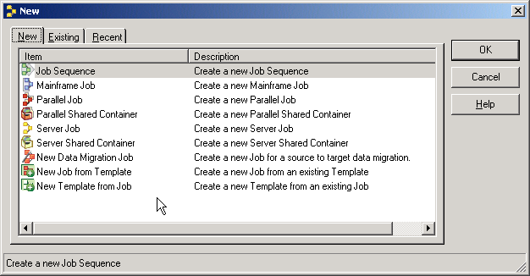
Designer - Create New Job – contd..
© 2004 Capgemini - All rights reserved
May 04 – Remote Configuration, Himanshu Gupta

Slide 60
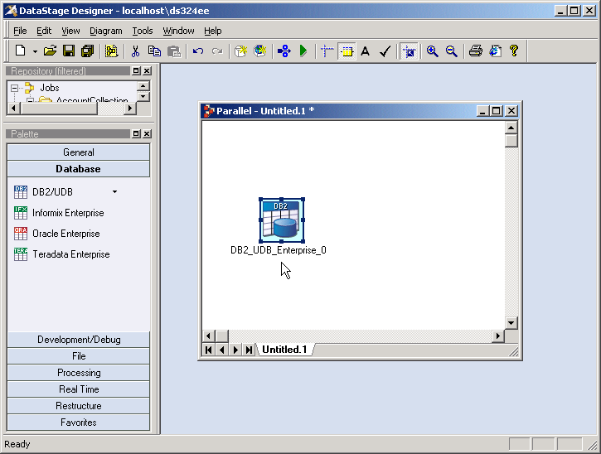
Drag Stages and Links Using Palette
© 2004 Capgemini - All rights reserved
May 04 – Remote Configuration, Himanshu Gupta
Notes:
The tools palette may be shown as a floating dock or placed along a border. Alternatively, it may be hidden and the developer may choose to pull needed stages from the repository onto the design work area.

Slide 61
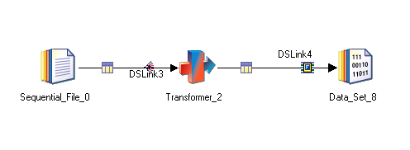
Assign Meta Data
Metadata or column definitions can be loaded into any of the Source or Target stages by clicking the “Load” option inside the Stage’s Output tab.
© 2004 Capgemini - All rights reserved
May 04 – Remote Configuration, Himanshu Gupta
Notes:
Meta data may be dragged from the repository and dropped on a link.

Slide 62
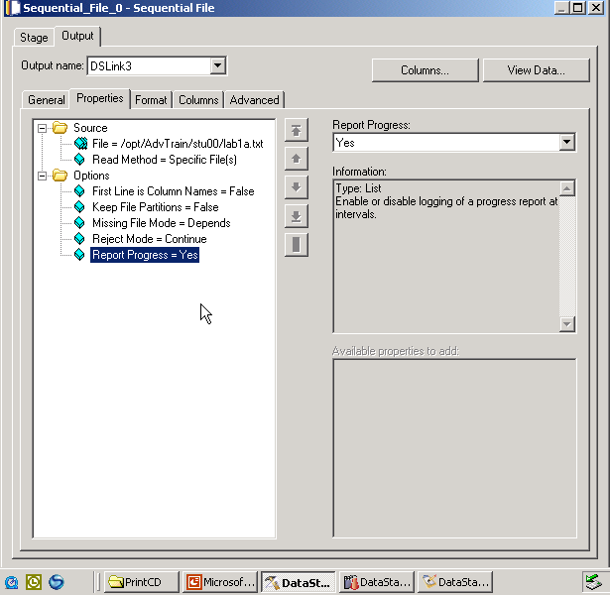
Editing a Sequential File Stage - Source
© 2004 Capgemini - All rights reserved
May 04 – Remote Configuration, Himanshu Gupta
Notes:
Any required properties that are not completed will appear in red.
You are defining the format of the data flowing out of the stage, that is, to the output link. Define the output link listed in the Output name box.
You are defining the file from which the job will read. If the file doesn’t exist, you will get an error at run time.
On the Format tab, you specify a format for the source file.
You will be able to view its data using the View data button.
Think of a link as like a pipe. What flows in one end flows out the other end (at the transformer stage).

Slide 63
Editing a Sequential File Stage - Target
© 2004 Capgemini - All rights reserved
May 04 – Remote Configuration, Himanshu Gupta
Notes:
Defining a sequential target stage is similar to defining a sequential source stage.
You are defining the format of the data flowing into the stage, that is, from the input links. Define each input link listed in the Input name box.
You are defining the file the job will write to. If the file doesn’t exist, it will be created. Specify whether to overwrite or append the data in the Update action set of buttons.
On the Format tab, you can specify a different format for the target file than you specified for the source file.
If the target file doesn’t exist, you will not (of course!) be able to view its data until after the job runs. If you click the View data button, DataStage will return a “Failed to open …” error.
The column definitions you defined in the source stage for a given (output) link will appear already defined in the target stage for the corresponding (input) link.
Think of a link as like a pipe. What flows in one end flows out the other end. The format going in is the same as the format going out.

Slide 64
Transformer Stage
In the Transformer stage you can specify:
Column mappings - A column mapping maps an input column to an output column. Values are passed directly from the input column to the output column.
Derivations - Derivations calculate the values to go into output columns based on values in zero or more input columns.
Constraints - Constraints specify the conditions under which incoming rows will be written to output links.
© 2004 Capgemini - All rights reserved
May 04 – Remote Configuration, Himanshu Gupta
Notes:
In the Transformer stage you can specify:
· Column mappings
· Derivations
· Constraints
A column mapping maps an input column to an output column. Values are passed directly from the input column to the output column.
Derivations calculate the values to go into output columns based on values in zero or more input columns.
Constraints specify the conditions under which incoming rows will be written to output links.

Slide 65
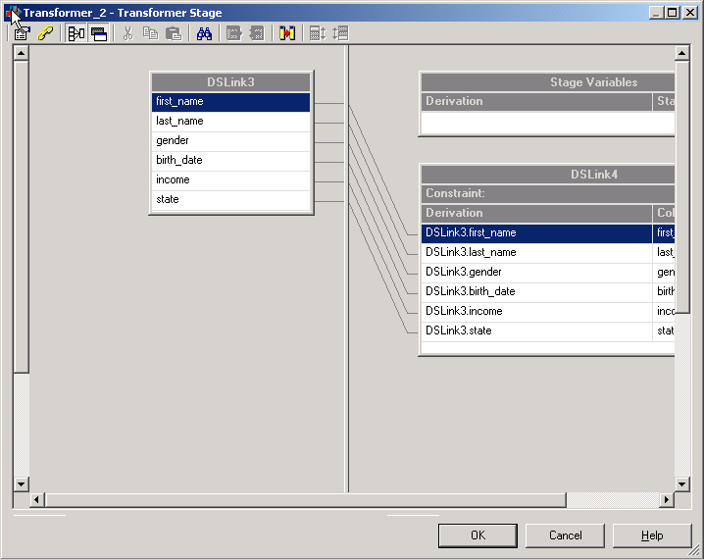
Transformer Stage Elements
© 2004 Capgemini - All rights reserved
May 04 – Remote Configuration, Himanshu Gupta
Notes:
There are two: transformer and basic transformer. Both look the same but access different routines and functions.
Notice the following elements of the transformer:
The top, left pane displays the columns of the input links.
The top, right pane displays the contents of the stage variables.
The lower, right pane displays the contents of the output link. Unresolved column mapping will show the output in red.
For now, ignore the Stage Variables window in the top, right pane. This will be discussed in a later module.
The bottom area shows the column definitions (metadata) for the input and output links.

Slide 66
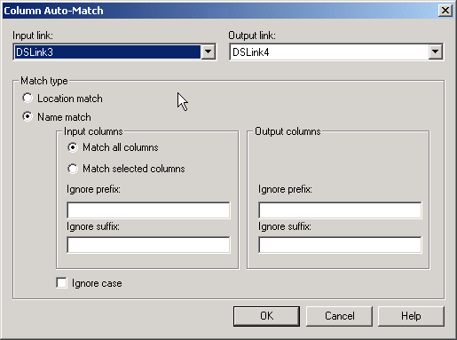
Create Column Mappings
Drag and Drop required input fields from the left pane to the output on the right hand pane
Column Auto-Match
© 2004 Capgemini - All rights reserved
May 04 – Remote Configuration, Himanshu Gupta

Slide 67
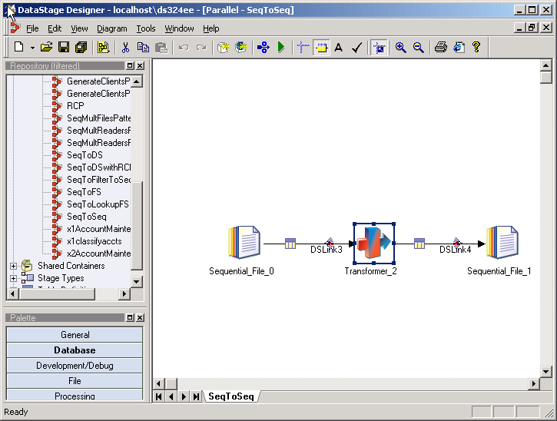
End Result - Job
© 2004 Capgemini - All rights reserved
May 04 – Remote Configuration, Himanshu Gupta

Slide 68
Job Parameters
Makes the job more flexible
Parameters can be:
  Used in constraints and derivations
  Used in directory and file names
  Used across stages in a job
Parameter values are determined at run time
Are defined in the Job Properties>Parameters tab in the DS Job canvas
Can be called/used in the job by enclosing the defined parameter names in with ‘#’ – Eg: #Parameter_name#
© 2004 Capgemini - All rights reserved
May 04 – Remote Configuration, Himanshu Gupta

Slide 69
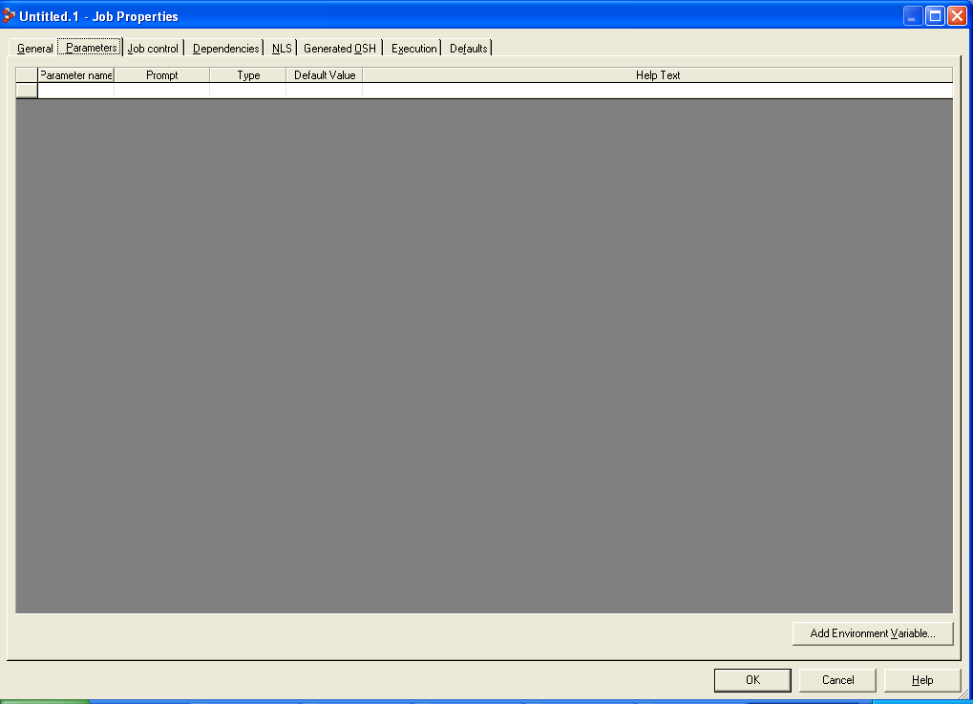
Job Parameters – contd..
© 2004 Capgemini - All rights reserved
May 04 – Remote Configuration, Himanshu Gupta

Slide 70
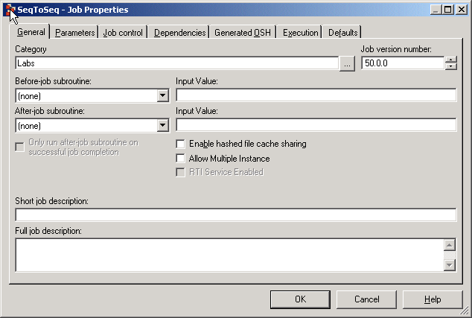
Job Documentation
Job Properties
  Short and long descriptions
  Shows in Manager
© 2004 Capgemini - All rights reserved
May 04 – Remote Configuration, Himanshu Gupta

Slide 71
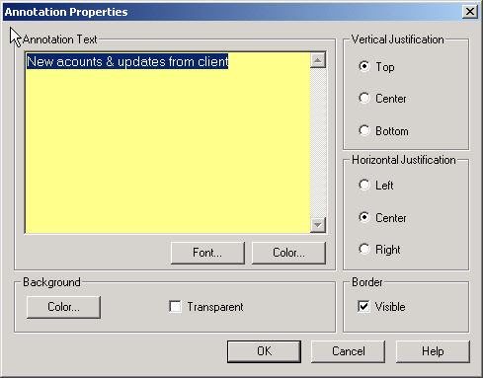
Job Documentation – contd..
Annotation stage
  Is a stage on the tool palette
  Shows on the job canvas
© 2004 Capgemini - All rights reserved
May 04 – Remote Configuration, Himanshu Gupta
Notes:
You can type in whatever you want; the default text comes from the short description of the jobs properties you entered, if any.
Add one or more Annotation stages to the canvas to document your job.
An Annotation stage works like a text box with various formatting options. You can optionally show or hide the Annotation stages by pressing a button on the toolbar.
There are two Annotation stages. The Description Annotation stage is discussed in a later slide.

Slide 72
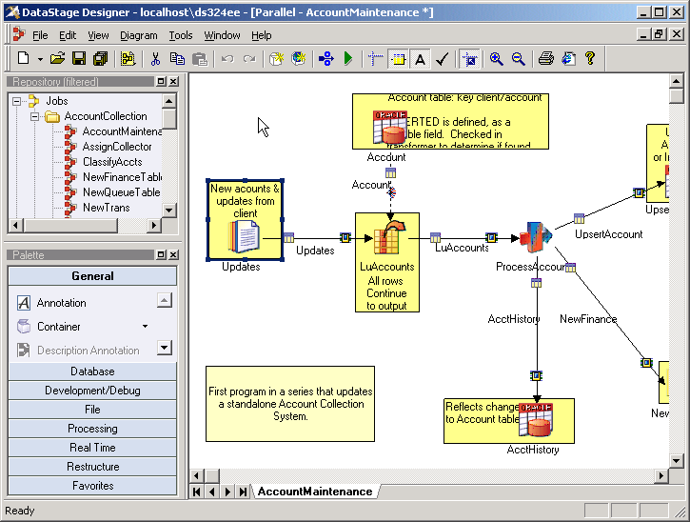
Final Job with Documentation
© 2004 Capgemini - All rights reserved
May 04 – Remote Configuration, Himanshu Gupta

Slide 73
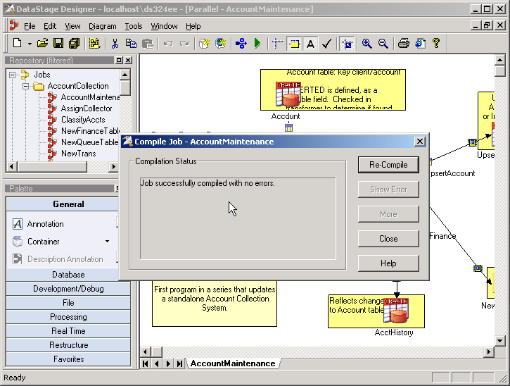
Compiling a Job
Before the job can be run, it must be compiled. To compile it, click ‘File>Compile’ or click the Compile button on the toolbar.
A compile will generate OSH.
© 2004 Capgemini - All rights reserved
May 04 – Remote Configuration, Himanshu Gupta

Slide 74
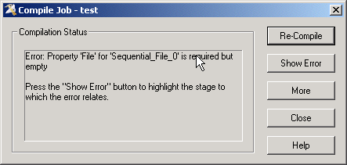
Compilation Errors or Successful Message
If an error occurs:
Click “Show Error” to identify the stage where the error occurred. This will highlight the stage in error.
Click “More” to retrieve more information about the error. This can be lengthy for parallel jobs.
© 2004 Capgemini - All rights reserved
May 04 – Remote Configuration, Himanshu Gupta
Notes:
If an error occurs:
Click Show Error to identify the stage where the error occurred. This will highlight the stage in error.
Click More to retrieve more information about the error. This can be lengthy for parallel jobs.

Slide 75
Introduction Part 5
DataStage Director and Running DataStage Jobs
© 2004 Capgemini - All rights reserved
May 04 – Remote Configuration, Himanshu Gupta

Slide 76
Module Objectives
After this module you will be able to:
  Validate your job
  Use DataStage Director to run your job
  Set to run options
  Monitor your job’s progress
  View job log messages
© 2004 Capgemini - All rights reserved
May 04 – Remote Configuration, Himanshu Gupta

Slide 77
DataStage Director
Can Validate, Run and schedule jobs
Can be invoked from DataStage Manager or Designer
  Tools > Director
There are two methods for running a job:
Run it immediately.
Schedule it to run at a later time or date
To run a job immediately:
Select the job in the Job Status view. The job must have been compiled.
Click Job>Run Now or click the Run Now button in the toolbar. The Job Run Options window is displayed.
© 2004 Capgemini - All rights reserved
May 04 – Remote Configuration, Himanshu Gupta
Notes:
As you know, you run your jobs in Director. You can open Director from within Designer by clicking Tools>Run Director.
In a similar way, you can move between Director, Manager, and Designer.
There are two methods for running a job:
· Run it immediately.
· Schedule it to run at a later time or date.
To run a job immediately:
· Select the job in the Job Status view. The job must have been compiled.
· Click Job>Run Now or click the Run Now button in the toolbar. The Job Run Options window is displayed.

Slide 78
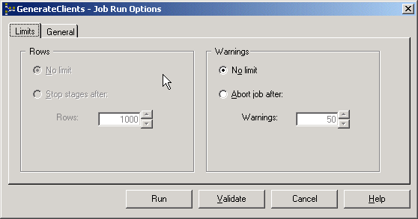
Run Options – Parameters and Limits
This window allows you to stop the job after:
A certain number of rows.
A certain number of warning messages.
Validation performs some checks that are necessary in order for
a job to run successfully. These include:
Verifying that connections to data sources can be made.
Verifying that files can be opened.
Verifying that SQL statements used to select data can be prepared.
© 2004 Capgemini - All rights reserved
May 04 – Remote Configuration, Himanshu Gupta
Notes:
The Job Run Options window is displayed when you click Job>Run Now.
This window allows you to stop the job after:
· A certain number of rows.
· A certain number of warning messages.
You can validate your job before you run it. Validation performs some checks that are necessary in order for your job to run successfully. These include:
· Verifying that connections to data sources can be made.
· Verifying that files can be opened.
· Verifying that SQL statements used to select data can be prepared.
Click Run to run the job after it is validated. The Status column displays the status of the job run.

Slide 79
Job Log in Director
Click the Log button in the toolbar to view the job log. The job log
records events that occur during the execution of a job.
These events include - control events, such as the starting,
finishing, and aborting of a job; informational messages; warning
messages; error messages; and program-generated messages.
Double click on a particular event entry to view the complete entry for that
Event.
© 2004 Capgemini - All rights reserved
May 04 – Remote Configuration, Himanshu Gupta

Slide 80
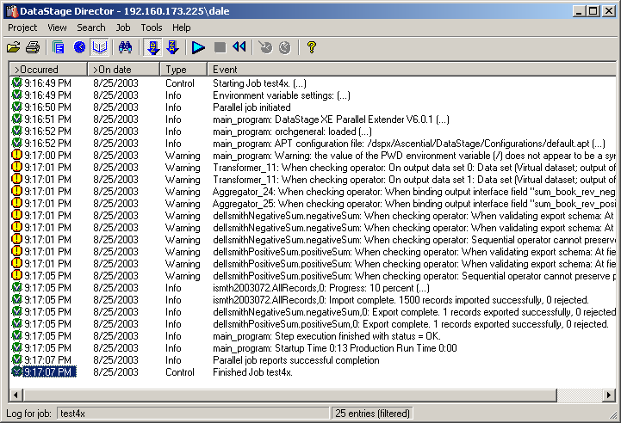
Director Log View
© 2004 Capgemini - All rights reserved
May 04 – Remote Configuration, Himanshu Gupta

Slide 81
Other Director Functions
Monitor Job run
Schedule job to run on a particular date/time
Reset job
Clear job log
Set Director options
  Row limits
  Abort after x warnings
© 2004 Capgemini - All rights reserved
May 04 – Remote Configuration, Himanshu Gupta

Slide 82
Introduction to DataStage Enterprise Edition
© 2004 Capgemini - All rights reserved
May 04 – Remote Configuration, Himanshu Gupta

Slide 83
Course Agenda
Day 1
  Review of EE Concepts
  Sequential Access
  Standards
  DBMS Access
Day 2
  EE Architecture
  Transforming Data
  Sorting Data
Day 3
  Combining Data
  Configuration Files
Day 4
  Extending EE
  Meta Data Usage
  Job Control
  Testing
© 2004 Capgemini - All rights reserved
May 04 – Remote Configuration, Himanshu Gupta

Slide 84
Module 1
DataStage Enterprise Edition – Concepts of Parallelism
© 2004 Capgemini - All rights reserved
May 04 – Remote Configuration, Himanshu Gupta

Slide 85
Why EE is so Effective
Parallel processing paradigm
  More hardware, faster processing
  Level of parallelization is determined by a configuration file read at runtime
Emphasis on memory
  Data read into memory and lookups performed like hash table
Lets see how?
© 2004 Capgemini - All rights reserved
May 04 – Remote Configuration, Himanshu Gupta

Slide 86
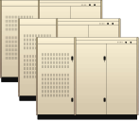

Traditional Batch Processing
Operational Data
Transform
Clean
Load
Archived Data
Data
Warehouse
Disk
Disk
Disk
Source
Target
Traditional approach to batch processing:
Write to disk and read from disk before each processing operation
Sub-optimal utilization of resources
  a 10 GB stream leads to 70 GB of I/O
  processing resources can sit idle during I/O
Very complex to manage (lots and lots of small jobs)
Becomes impractical with big data volumes
  disk I/O consumes the processing
  terabytes of disk required for temporary staging
© 2004 Capgemini - All rights reserved
May 04 – Remote Configuration, Himanshu Gupta

Slide 87
Parallelism
There are two basic types of parallel processing –
1. Pipeline Multiprocessing
2. Partition Parallelism
DataStage allows you to use both of these methods.
© 2004 Capgemini - All rights reserved
May 04 – Remote Configuration, Himanshu Gupta

Slide 88
Pipeline Multiprocessing
Transform, clean and load processes are executing simultaneously
on the same processor
Rows are moving forward through the flow
Start a downstream process while an upstream process is still running.
This eliminates intermediate storing to disk, which is critical for big data.
This also keeps the processors busy.
Think of a conveyor belt moving the rows from process to process!
Source
Target
Transform
Clean
Load
Data
Warehouse
© 2004 Capgemini - All rights reserved
May 04 – Remote Configuration, Himanshu Gupta

Slide 89
Partition Parallelism
Break up big data into partitions
Run one partition on each processor
4X times faster
on 4 processors –
With data big enough:
100X faster on 100 processors
This is exactly how the parallel
databases work!
Transform
Node 1
A-F
Transform
Node 2
Source
Data
G- M
N-T
Transform
Node 3
U-Z
Transform
Node 4
© 2004 Capgemini - All rights reserved
May 04 – Remote Configuration, Himanshu Gupta

Slide 90

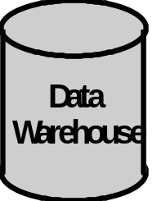
Parallelism in DataStage
Pipelining and partitioning can be combined together to provide a powerful parallel processing paradigm.
Pipelining
Partitioning
Transform
Clean
Load
Source
Target
© 2004 Capgemini - All rights reserved
May 04 – Remote Configuration, Himanshu Gupta
Notes:
Pipelining and partitioning can be combined together to provide a powerful parallel processing paradigm.

Slide 91
Repartitioning
Putting It All Together: Parallel Dataflow
with Repartioning on-the-fly
Pipelining
Partitioning
Repartitioning
Repartitioning
U-Z
N-T
G- M
Transform
Clean
Load
A-F
Customer last name
Customer zip code
Credit card number
Target
Without Landing To Disk!
© 2004 Capgemini - All rights reserved
May 04 – Remote Configuration, Himanshu Gupta

Slide 92
Parallelism Concepts - Review
Parallel Processing
  Pipeline Parallelism
    Each activity (Stage) Starts in its own process.
    Data is exchanged between the processes using named pipes.
  Partition Parallelism
    Multiple copies of the Job are created.
    Number of copies depends upon the Configuration file.
    Data is partitioned (Split) between these partitions and processed independently (unless repartitioned) in parallel.
  Combining both
    DataStage processes data using both Pipeline and Partition Parallelism providing the fast volumes necessary for large volumes of data.
  Repartitioning data
    Data once split between the copies, can be repartitioned (divided again)
    This may be needed to ensure that related data is processed together.
© 2004 Capgemini - All rights reserved
May 04 – Remote Configuration, Himanshu Gupta

Slide 93
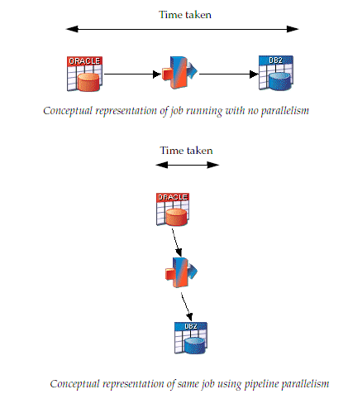
Parallel Processing (Pictorial)
Parallel Processing (Pictorial)
  Pipeline Parallelism
© 2004 Capgemini - All rights reserved
May 04 – Remote Configuration, Himanshu Gupta

Slide 94

Parallel Processing (Pictorial) – contd..
Parallel Processing (Pictorial)
  Partition Parallelism
© 2004 Capgemini - All rights reserved
May 04 – Remote Configuration, Himanshu Gupta

Slide 95
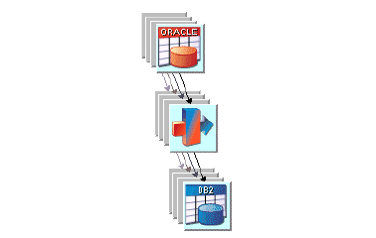
Parallel Processing (Pictorial) – contd..
Parallel Processing (Pictorial)
  Combining both
© 2004 Capgemini - All rights reserved
May 04 – Remote Configuration, Himanshu Gupta

Slide 96
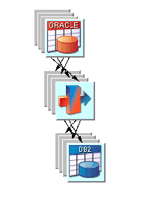
Parallel Processing (Pictorial) – contd..
Parallel Processing (Pictorial)
  Repartitioning data
© 2004 Capgemini - All rights reserved
May 04 – Remote Configuration, Himanshu Gupta

Slide 97





Partitioning Modes and Repartitioning
Partitioning
  Round Robin
  Random
  Same
  Entire
  Hash
  Modulus
  Range
  DB2
  Auto
Collecting
  Round Robin
  Ordered
  Sort Merge
  Auto
© 2004 Capgemini - All rights reserved
May 04 – Remote Configuration, Himanshu Gupta

Slide 98
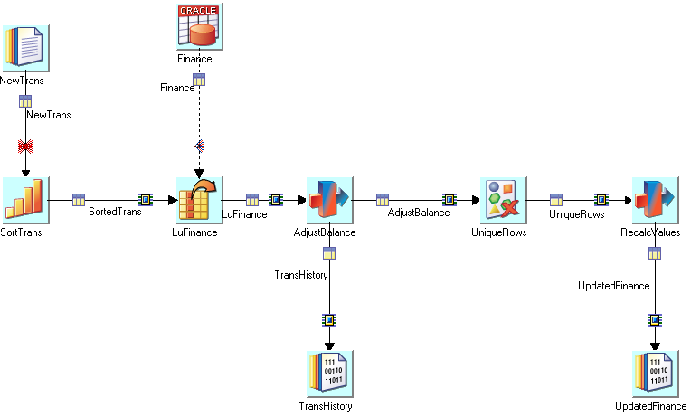
Example Partitioning Icons
partitioner
© 2004 Capgemini - All rights reserved
May 04 – Remote Configuration, Himanshu Gupta

Slide 99
Parallel Processing Systems
DataStage EE Enables parallel processing = executing your application on
multiple CPUs simultaneously
Addition of more resources (CPUs, RAM, and disks) can increase
system performance
1
2
Example system containing
6 CPUs (or processing nodes)
and disks
3
4
5
6
© 2004 Capgemini - All rights reserved
May 04 – Remote Configuration, Himanshu Gupta

Slide 100
Scaleable Systems: Examples
Three main types of scalable systems
Symmetric Multiprocessors (SMP): shared memory and disk
Clusters: UNIX systems connected via networks
MPP: Massively Parallel Processing
© 2004 Capgemini - All rights reserved
May 04 – Remote Configuration, Himanshu Gupta

Slide 101
SMP: Shared Everything
  Multiple CPUs with a single operating system
  Programs communicate using shared memory
  All CPUs share system resources
  (OS, memory with single linear address space, disks, I/O)
  When used with Enterprise Edition:
  Data transport uses shared memory
  Simplified startup
cpu
cpu
cpu
cpu
© 2004 Capgemini - All rights reserved
May 04 – Remote Configuration, Himanshu Gupta

Slide 102
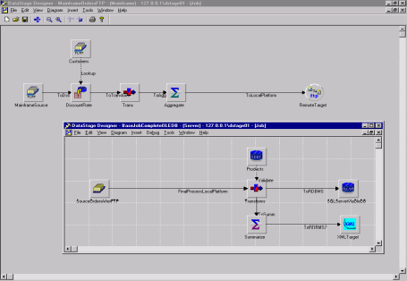
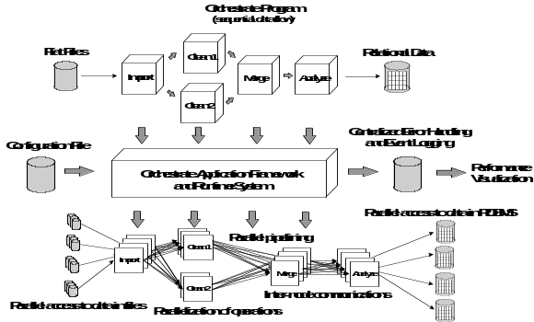
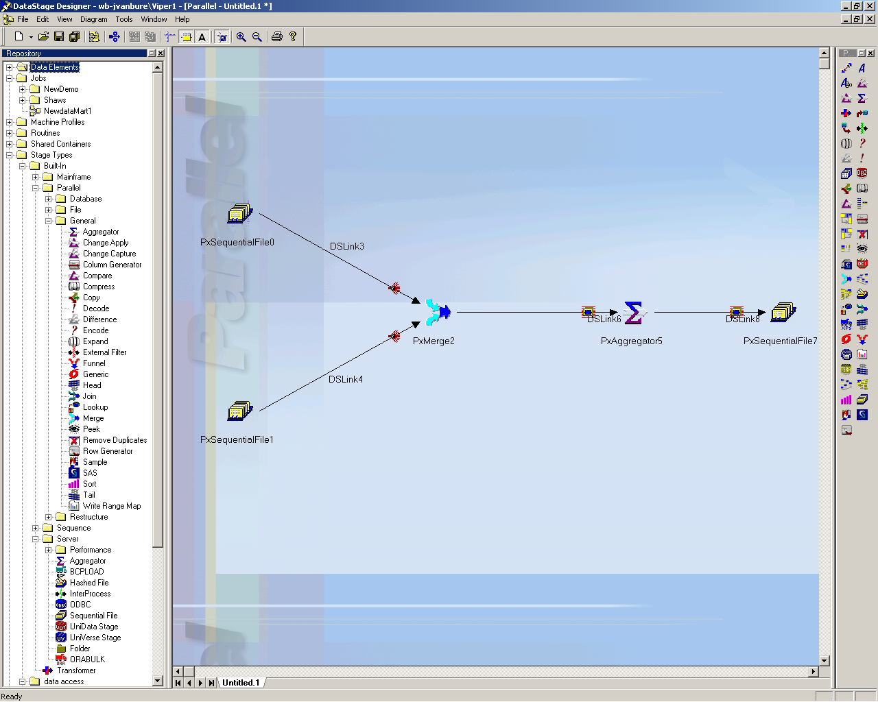
DataStage EE Architecture
DataStage:
Provides data integration platform
Orchestrate Framework:
Provides application scalability
DataStage Enterprise Edition:
Best-of-breed scalable data integration platform
No limitations on data volumes or throughput.
© 2004 Capgemini - All rights reserved
May 04 – Remote Configuration, Himanshu Gupta
Notes:
The Enterprise Edition engine was derived from DataStage and Orchestrate.

Slide 103
Module 2
DataStage Enterprise Edition - Parallel Jobs
© 2004 Capgemini - All rights reserved
May 04 – Remote Configuration, Himanshu Gupta

Slide 104
Introduction to DataStage EE
DSEE:
  Automatically scales to fit the machine
  Handles data flow among multiple CPU’s and disks
With DSEE you can:
  Create applications for SMPs, clusters and MPPs
  Enterprise Edition is architecture-neutral
  Access relational databases in parallel
  Execute external applications in parallel
  Store data across multiple disks and nodes
© 2004 Capgemini - All rights reserved
May 04 – Remote Configuration, Himanshu Gupta
Notes:
Enterprise Edition is architecturally neutral -- it can run on SMP's, clusters, and MPP's. The configuration file determines how Enterprise Edition will treat the hardware.

Slide 105
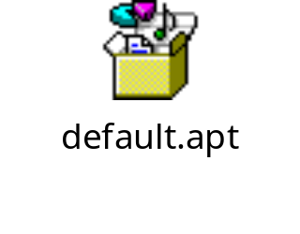
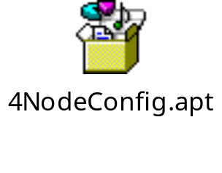
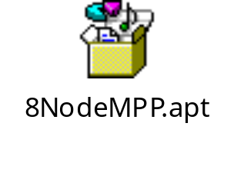
Configuration File
One of the great strengths of the DataStage Enterprise Edition is that, when designing jobs, you don’t have to worry too much about the underlying structure of your system. This flexibility is provided by the Configuration File.
DataStage learns about the shape and size of the system from the configuration file. It organizes the resources needed for a job according to what is defined in the configuration file. When your system changes, you change the file not the jobs.
When you install DataStage Enterprise Edition the system is automatically
configured to use the supplied default configuration file – default.apt.
© 2004 Capgemini - All rights reserved
May 04 – Remote Configuration, Himanshu Gupta

Slide 106
Configuration File – contd..
default.apt
Node Name (Logical node)
{
node "node1"
{
fastname "ascdev1"
pools ""
resource disk "/opt/etl/data" {pools ""}
resource scratchdisk "/opt/etl/scratch" {pools ""}
}
}
Node Name on the Network
(Physical node)
Directory for permanent storage
Directory for temporary storage
© 2004 Capgemini - All rights reserved
May 04 – Remote Configuration, Himanshu Gupta

Slide 107
Configuration File – contd..
The configuration file describes:
the available processing power in terms of processing nodes
every processing node and disk space connected to each node that DataStage will use to run the application.
When a job is run, DataStage first reads the configuration file to determine the available system resources.
The number of nodes defined in the configuration file determines how many instances of a process will be produced when the parallel job is run.
Since the parallel engine reads the configuration file every time it runs a Parallel job, it automatically scales the application to fit the system, without having to alter the job code. This is called Scalability.
The proper configuration of scratch and resource disks and the underlying
file system and physical hardware architecture can significantly affect
overall job performance.
© 2004 Capgemini - All rights reserved
May 04 – Remote Configuration, Himanshu Gupta

Slide 108
Optimizing Parallelism
The degree of parallelism of a parallel job is determined by the number
of nodes defined when the parallel engine is configured.
Parallelism should be optimized for the hardware rather than simply
maximized. Increasing parallelism distributes the work load but it also
adds to overhead because the number of processes increases.
Increased parallelism can actually hurt performance once the capacity of
hardware exceeds.
© 2004 Capgemini - All rights reserved
May 04 – Remote Configuration, Himanshu Gupta

Slide 109




Job Design VS. Execution
Developer assembles data flow using the Designer
…and gets: parallel access, propagation, transformation, and load.
The design is good for 1 node, 4 nodes,
or N nodes. To change # nodes, just swap configuration file.
No need to modify or recompile the design
© 2004 Capgemini - All rights reserved
May 04 – Remote Configuration, Himanshu Gupta
Notes:
Much of the parallel processing paradigm is hidden from the programmer -- they simply designate process flow as shown in the upper portion of this diagram. Enterprise Edition, using the definitions in that configuration file, will actually execute UNIX processes that are partitioned and parallelized.

Slide 110
EE Program Elements
Dataset: uniform set of rows in the Framework's internal representation
  - Three flavors:
  1. file sets *.fs : stored on multiple Unix files as flat files
  2. persistent: *.ds : stored on multiple Unix files in Framework format
  read and written using the DataSet Stage
  3. virtual: *.v : links, in Framework format, NOT stored on disk
  - The Framework processes only datasets—hence possible need for Import
  - Different datasets typically have different schemas
  - Convention: "dataset" = Framework data set.
Partition: subset of rows in a dataset earmarked for processing by the same node (virtual CPU, declared in a configuration file).
- All the partitions of a dataset follow the same schema: that of the dataset
© 2004 Capgemini - All rights reserved
May 04 – Remote Configuration, Himanshu Gupta

Slide 111
EE Program Elements – contd..
The EE Framework processes only datasets because partitioning works only with data sets. You must use data sets to distribute data to the multiple processing nodes of a parallel system.
For files other than datasets, such as flat files, or for sources such as RDBMS, Enterprise Edition must perform import and export operations – this is performed by import and export Orchestrate operators generated by the source stages
During import or export DataStage performs format translations – into, or out of, the EE internal format (datasets)
Data is described to the Framework in a schema
© 2004 Capgemini - All rights reserved
May 04 – Remote Configuration, Himanshu Gupta

Slide 112
DataStage Concepts
Runtime Column Propagation (RCP)
  DataStage is flexible about meta data.
  It can cope with the situation where meta data isn’t fully defined.
  You can define part of your schema and specify that, if your job encounters extra columns that are not defined in the meta data when it actually runs, it will adopt these extra columns and propagate them through the rest of the job.
  This is known as runtime column propagation (RCP).
© 2004 Capgemini - All rights reserved
May 04 – Remote Configuration, Himanshu Gupta

Slide 113
Module 3
DSEE Sequential Access and Files
© 2004 Capgemini - All rights reserved
May 04 – Remote Configuration, Himanshu Gupta

Slide 114
Module Objectives
You will learn to:
  Import sequential files into the EE Framework
  Utilize parallel processing techniques to increase sequential file access
  Understand usage of the Sequential, DataSet, FileSet, and LookupFileSet stages
  Manage partitioned data stored by the Framework
© 2004 Capgemini - All rights reserved
May 04 – Remote Configuration, Himanshu Gupta

Slide 115
Types of File Stages
Sequential
  Fixed or variable length
File Set
Lookup File Set
Data Set
© 2004 Capgemini - All rights reserved
May 04 – Remote Configuration, Himanshu Gupta

Slide 116
How the Stages Works
Generates Import/Export operators, depending on whether stage is source or target
Performs direct C++ file I/O streams
© 2004 Capgemini - All rights reserved
May 04 – Remote Configuration, Himanshu Gupta

Slide 117

Using the Sequential File Stage
Both import and export of general files (text, binary) are performed by the
SequentialFile Stage.
Data import:
Data export
When data is imported the imported operator translates that data into the Enterprise Edition internal format. The export operator performs the reverse action.
Importing/Exporting Data
EE internal format
EE internal format
© 2004 Capgemini - All rights reserved
May 04 – Remote Configuration, Himanshu Gupta
Notes:
When data is imported the imported operator translates that data into the Enterprise Edition internal format. The export operator performs the reverse action.

Slide 118
Working With Flat/Sequential Files
Sequential File Stage
  Normally will execute in sequential mode
  Can be parallel if reading multiple files (file pattern option)
  Can use multiple readers within a node
Both export and import operators are generated by the sequential stage – which
one you get depends on whether the sequential stage is used as source or
target.
DSEE needs to know
  How file is divided into rows
  How row is divided into columns
© 2004 Capgemini - All rights reserved
May 04 – Remote Configuration, Himanshu Gupta

Slide 119
Processes Needed to Import Data
Recordization
  Divides input stream into records
  Set on the format tab
Columnization
  Divides the record into columns
  Default set on the format tab but can be overridden on the columns tab
  Can be “incomplete” if using a schema or not even specified in the stage if using RCP
These two processes must work together to correctly interpret data
-- that is, to break a data string down into records and columns.
© 2004 Capgemini - All rights reserved
May 04 – Remote Configuration, Himanshu Gupta

Slide 120
Sequential File Stage
To set the properties, use stage editor
  Page (general, input/output)
  Tabs (format, columns)
Sequential stage link rules
  One input link
  One output links (except for reject link definition)
  One reject link
    Will reject any records not matching meta data in the column definitions
© 2004 Capgemini - All rights reserved
May 04 – Remote Configuration, Himanshu Gupta

Slide 121
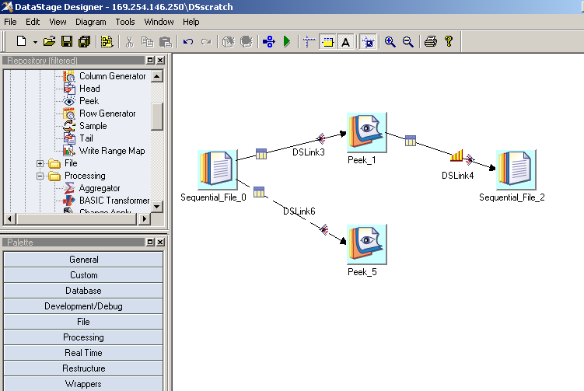
Job Design Using Sequential Stages
Reject Link
Stage categories
© 2004 Capgemini - All rights reserved
May 04 – Remote Configuration, Himanshu Gupta

Slide 122

Sequential File Stage – contd..
General Tab
Multiple output links
Show records
© 2004 Capgemini - All rights reserved
May 04 – Remote Configuration, Himanshu Gupta

Slide 123

Sequential File Stage – contd..
Properties Tab
  Read a list of files that are unrelated in name, but have the same meta data - Read Method = Specific File(s)
  Set “Read Method” to “File Pattern”, to read an undetermined number of files through a wild character, Eg: bb*.txt
Click to add more files having the same meta data.
© 2004 Capgemini - All rights reserved
May 04 – Remote Configuration, Himanshu Gupta

Slide 124

Sequential File Stage – contd..
Format Tab
Column properties set on this tab are defaults for each column; they can be overridden at the column level (from columns tab)
Record into columns
File into records
© 2004 Capgemini - All rights reserved
May 04 – Remote Configuration, Himanshu Gupta
Notes:
DXEE needs to know:
How a file is divided into rows
How a row is divided into columns
Column properties set on this tab are defaults for each column; they can be overridden at the column level (from columns tab).

Slide 125
Sequential File Stage – contd..
Reject Link
Reject mode = Output
From Source
  All records not matching the meta data (the column definitions)
From Target
  All records that are rejected for any reason
Meta data for the reject link – one column, datatype = raw
© 2004 Capgemini - All rights reserved
May 04 – Remote Configuration, Himanshu Gupta
Notes:
The sequential stage can have a single reject link. This is typically used when you are writing to a file and provides a location where records that have failed to be written to a file for some reason can be sent. When you are reading files, you can use a reject link as a destination for rows that do not match the expected column definitions.

Slide 126

Data Set
Orchestrate system (Framework) file
Suffixed by .ds
Referred to by a control file
Managed by Data Set Management utility from GUI (Manager, Designer, Director)
Represents persistent data
Key to good performance in set of linked jobs
© 2004 Capgemini - All rights reserved
May 04 – Remote Configuration, Himanshu Gupta

Slide 127
Data Set – contd..
Accessed from/to disk with DataSet Stage.
Two parts:
  Descriptor file:
    contains metadata, data location, but NOT the data itself
  Data file(s)
    contain the data
    multiple Unix files (one per node), accessible in parallel
    Each file gets created in the resource disk mentioned for that node in the config file
Manually deleting a data set from the physical location where it resides
does not remove the Data set, as this only removes the Control File, thus
making it impossible for DS to retrieve the data stored inside, as the
Information regarding the location of the Data Files are lost with the Ctrl
File.
record (
partno: int32;
description: string;
)
node1:/local/disk1/…
node2:/local/disk2/…
© 2004 Capgemini - All rights reserved
May 04 – Remote Configuration, Himanshu Gupta

Slide 128
Data Set – contd..
Descriptor file
  User-specified name
  Contains table definition ("unformatted core" schema)
Descriptor file, e.g., "input.ds" contains:
  Paths of data files
  Metadata: unformatted table definition, no formats (unformatted schema)
  Configuration file used to store the data
  Information on Partition and Sorting order used to create the data set
Data file(s)
  Contain the data itself
  System-generated long file names, to avoid naming conflicts
© 2004 Capgemini - All rights reserved
May 04 – Remote Configuration, Himanshu Gupta

Slide 129


Quiz
Is the data partitioned?
© 2004 Capgemini - All rights reserved
May 04 – Remote Configuration, Himanshu Gupta

Slide 130
Managing Data Sets
GUI (Manager, Designer, Director) – Tools > Data set management
Orchadmin
    Unix command line utility
    List records
    Remove data sets (will remove all components)
    Lot of other data set functionalities also can be achieved by this utility
Dsrecords
    Unix command line utility
    Lists number of records in a dataset
© 2004 Capgemini - All rights reserved
May 04 – Remote Configuration, Himanshu Gupta

Slide 131

Data Set Management
Display data
Schema
© 2004 Capgemini - All rights reserved
May 04 – Remote Configuration, Himanshu Gupta
Notes:
The screen is available (data sets management) from manager, designer, and director.

Slide 132
Data Set Management From Unix
Alternative method of managing file sets and data sets
  Dsrecords
    Gives record count
      $ dsrecords ds_name
      $ dsrecords myDS.ds
        156999 records
  Orchadmin
    Manages EE persistent data sets
      $ orchadmin rm myDataSet.ds
© 2004 Capgemini - All rights reserved
May 04 – Remote Configuration, Himanshu Gupta

Slide 133
Engine Data Translation
Occurs on import
  From sequential files or file sets
  From RDBMS
Occurs on export
  From datasets to file sets or sequential files
  From datasets to RDBMS
Engine most efficient when processing internally formatted records
(I.e. data contained in datasets)
© 2004 Capgemini - All rights reserved
May 04 – Remote Configuration, Himanshu Gupta

Slide 134

File Set Stage
Similar to Data set except that they are not in the Enterprise Edition internal format
Can read or write file sets
Files suffixed by .fs
File set consists of:
  Descriptor file – contains location of raw data files + meta data
  Individual raw data files
Can be processed in parallel
© 2004 Capgemini - All rights reserved
May 04 – Remote Configuration, Himanshu Gupta

Slide 135
File Set Usage
Why use a file set?
  2G limit on some file systems
  Need to distribute data among nodes to prevent overruns
  If used in parallel, runs faster that sequential file
© 2004 Capgemini - All rights reserved
May 04 – Remote Configuration, Himanshu Gupta

Slide 136


File Set Stage Example
Descriptor file
© 2004 Capgemini - All rights reserved
May 04 – Remote Configuration, Himanshu Gupta
Notes:
The descriptor file shows both a record is metadata and the file's location. The location is determined by the configuration file.

Slide 137

Lookup File Set Stage
Similar to File Sets except that it contains information about the key columns
Used in conjunction with Lookup stages
Has to be created before it can be used with a Look up
Used for optimum performance when dealing with huge volume of reference data
© 2004 Capgemini - All rights reserved
May 04 – Remote Configuration, Himanshu Gupta
Notes:
The lookup file set is similar to the file set but also contains information about the key columns. These keys will be used later in lookups.

Slide 138


Lookup File Set Stage – contd..
Key column specified
Key column dropped in descriptor file
© 2004 Capgemini - All rights reserved
May 04 – Remote Configuration, Himanshu Gupta

Slide 139
Module 4
Standards and Techniques
© 2004 Capgemini - All rights reserved
May 04 – Remote Configuration, Himanshu Gupta

Slide 140
Objectives
Establish standard techniques for DSEE development
Will cover:
  Job documentation
  Naming conventions for jobs, links, and stages
  Iterative job design
  Useful stages for job development
  Using configuration files for development
  Using environmental variables
  Job parameters
© 2004 Capgemini - All rights reserved
May 04 – Remote Configuration, Himanshu Gupta

Slide 141

Job Presentation
Document using the annotation stage
© 2004 Capgemini - All rights reserved
May 04 – Remote Configuration, Himanshu Gupta

Slide 142

Job Properties Documentation
Short Description
Long Description
Description through Annotations
Organize jobs into categories
Description shows in DS Manager and MetaStage
© 2004 Capgemini - All rights reserved
May 04 – Remote Configuration, Himanshu Gupta

Slide 143
Naming conventions
Stages named after the
  Source system and Data they access
  Function they perform
  DO NOT leave defaulted stage names like Sequential_File_0
Links named for the data they carry
  DO NOT leave defaulted link names like DSLink3
Each Development Project would have their own Naming Standards for
Stages and Links that need to be followed.
© 2004 Capgemini - All rights reserved
May 04 – Remote Configuration, Himanshu Gupta

Slide 144

Stage and Link Names
Stages and links renamed to data they handle
© 2004 Capgemini - All rights reserved
May 04 – Remote Configuration, Himanshu Gupta

Slide 145

Create Reusable Job Components
Use Enterprise Edition shared containers when and where feasible
Container
© 2004 Capgemini - All rights reserved
May 04 – Remote Configuration, Himanshu Gupta

Slide 146
Containers
Containers
A container is a group of stages and links. Containers enable you to simplify
and modularize your job designs by replacing complex areas of the diagram
with a single container stage.
2 types of Containers
Local Container
  Created within a job
  Only accessible by that job
  Can be used in Server/Parallel jobs
Shared Container
  Reusable by other jobs in the Project
  Can be Server Shared container or Parallel Shared container
A Server Shared container can be used in a Parallel job, but only in an
SMP environment and not on MPP.
© 2004 Capgemini - All rights reserved
May 04 – Remote Configuration, Himanshu Gupta

Slide 147

Creating a Container
Create a job
Select (loop) portions to containerize
Edit > Construct container > local or shared
© 2004 Capgemini - All rights reserved
May 04 – Remote Configuration, Himanshu Gupta

Slide 148

Use Iterative Job Design
Use copy or peek stage as stub
Test job in phases – small first, then increasing in complexity
Use Peek stage to examine records directly in the job log
Helps save space on the Server
Copy stage
© 2004 Capgemini - All rights reserved
May 04 – Remote Configuration, Himanshu Gupta

Slide 149

Copy Stage
With 1 link in, 1 link out:
the Copy Stage is the ultimate "no-op" (place-holder):
  Partitioners
  Sort / Remove Duplicates
  Rename, Drop column
… can be inserted on:
  input link (Partitioning): Partitioners, Sort, Remove Duplicates)
  output link (Mapping page): Rename, Drop.
Can be used to replace the Transformer stage:
  Rename,
  Drop,
  Implicit type Conversions
  Break up schema
© 2004 Capgemini - All rights reserved
May 04 – Remote Configuration, Himanshu Gupta

Slide 150
Transformer Stage Techniques
Suggestions –
  Always include reject link.
  Always test for null value before using a column in a function.
  Try to use RCP and only map columns that have a derivation other than a copy. More on RCP later.
Mandatory –
  Be aware of Column and Stage variable Data Types
    Often users do not pay attention to Stage Variable type
  Use conversion functions for data type conversions
    Try to maintain the data type as imported unless required
More about Transformer stage later!
© 2004 Capgemini - All rights reserved
May 04 – Remote Configuration, Himanshu Gupta

Slide 151
Developing Jobs
Keep it simple
  Jobs with many stages are hard to debug and maintain.
Start small and Build to final Solution
  Use view data, copy, and peek.
  Start from source and work out.
  Develop with multi node configuration file.
Solve the business problem before the performance problem.
  Job should meet the business requirement foremost
  Performance tuning is secondary to functionality
If you have to write to a Disk use a Persistent Data set.
© 2004 Capgemini - All rights reserved
May 04 – Remote Configuration, Himanshu Gupta

Slide 152
Good Things to Have in Each Job
Mandatorily use job parameters
Some helpful environmental variables to add to job parameters
  $APT_DUMP_SCORE
    Report OSH to message log
    Provides information on # of Processes and Operators involved in job
    Sometimes helps in debugging
  $APT_CONFIG_FILE
    Establishes runtime parameters to EE engine; i.e. Degree of parallelization
    Required for controlling the Parallelism
    Required for the Scalability of the job
© 2004 Capgemini - All rights reserved
May 04 – Remote Configuration, Himanshu Gupta

Slide 153

Setting Job Parameters
Click to add environment variables
© 2004 Capgemini - All rights reserved
May 04 – Remote Configuration, Himanshu Gupta

Slide 154


DUMP SCORE Output
Setting APT_DUMP_SCORE yields:
PartitonerAnd
Collector
Mapping
Node--> partition
© 2004 Capgemini - All rights reserved
May 04 – Remote Configuration, Himanshu Gupta

Slide 155
Use Multiple Configuration Files
Make a set for 1X, 2X,…. Configuration Files
Use different ones for test versus production
Include as a parameter in each job
Always set the APT_CONFIG_FILE environment variable to “$PROJDEF” to take the default value set at a Project level in the Administrator
Use appropriate Config files for the jobs
© 2004 Capgemini - All rights reserved
May 04 – Remote Configuration, Himanshu Gupta

Slide 156

Final Result
© 2004 Capgemini - All rights reserved
May 04 – Remote Configuration, Himanshu Gupta

Slide 157
Module 5
DBMS Access
© 2004 Capgemini - All rights reserved
May 04 – Remote Configuration, Himanshu Gupta

Slide 158
Objectives
Understand how DSEE reads and writes records to an RDBMS
Understand how to handle nulls on DBMS lookup
Utilize this knowledge to:
  Read and write database tables
  Use database tables to lookup data
  Use null handling options to clean data
© 2004 Capgemini - All rights reserved
May 04 – Remote Configuration, Himanshu Gupta

Slide 159
Parallel Database Connectivity
Traditional
Client-Server
Client
Enterprise Edition
Client
Sort
Client
Client
Client
Load
Client
Parallel RDBMS
Parallel RDBMS
Only RDBMS is running in parallel
Each application has only one connection
Suitable only for small data volumes
Parallel server runs APPLICATIONS
Application has parallel connections to RDBMS
Suitable for large data volumes
Higher levels of integration possible
© 2004 Capgemini - All rights reserved
May 04 – Remote Configuration, Himanshu Gupta

Slide 160
RDBMS Access Supported Databases
Enterprise Edition provides high performance / scalable interfaces for:
DB2
Informix
Oracle
Teradata
© 2004 Capgemini - All rights reserved
May 04 – Remote Configuration, Himanshu Gupta

Slide 161
RDBMS Access
Automatically convert RDBMS table layouts to/from Enterprise Edition Table Definitions
RDBMS nulls converted to/from nullable field values
Support for standard SQL syntax for specifying:
  field list for SELECT statement
  filter for WHERE clause
Can write an explicit SQL query to access RDBMS
EE supplies additional information in the SQL query
RDBMS access is relatively easy because Orchestrate extracts the schema
definition for the imported data set. Little or no work is required from the
user.
© 2004 Capgemini - All rights reserved
May 04 – Remote Configuration, Himanshu Gupta

Slide 162

RDBMS Enterprise Stages
DB2/UDB Enterprise
Informix Enterprise
Oracle Enterprise
Teradata Enterprise
Sybase Enterprise
© 2004 Capgemini - All rights reserved
May 04 – Remote Configuration, Himanshu Gupta

Slide 163
RDBMS Usage
As a source
  Extract data from table (stream link)
      Extract as table, generated SQL, or user-defined SQL
      User-defined can perform joins, access views
  Lookup (reference link)
      Normal lookup is memory-based (all table data read into memory)
      Can perform one lookup at a time in DBMS (sparse option)
      Continue/drop/fail options
As a target
  Inserts
  Upserts (Inserts and updates)
  Loads using a Bulk Loader
© 2004 Capgemini - All rights reserved
May 04 – Remote Configuration, Himanshu Gupta

Slide 164


RDBMS Source – Stream Link
Stream link
© 2004 Capgemini - All rights reserved
May 04 – Remote Configuration, Himanshu Gupta

Slide 165

RDBMS Source - User-defined SQL
Columns in SQL statement must match the meta data in columns tab
© 2004 Capgemini - All rights reserved
May 04 – Remote Configuration, Himanshu Gupta

Slide 166

RDBMS Source – Reference Link
Reject link
© 2004 Capgemini - All rights reserved
May 04 – Remote Configuration, Himanshu Gupta

Slide 167
Null Handling for Lookup Failures
Must handle null condition if lookup record is not found and “continue” option is chosen
Can be done in a Transformer Stage or a Modify Stage
This is applicable not only to Look ups from RDBMS, but for all reference
sources – be it Data set or Sequential File
© 2004 Capgemini - All rights reserved
May 04 – Remote Configuration, Himanshu Gupta

Slide 168

RDBMS as a Target
© 2004 Capgemini - All rights reserved
May 04 – Remote Configuration, Himanshu Gupta

Slide 169
RDBMS as a Target – contd..
Write Methods
  Delete - Delete Rows uses a DELETE SQL statement
  Load - Load uses the Oracle loader technology
  Upsert - Upsert uses an INSERT or an UPDATE SQL statement
Write mode for Load method
  Truncate - Truncate table records only
  Create - Create new table
  Replace - Replace by dropping table and creating new
  Append - Append to existing table
© 2004 Capgemini - All rights reserved
May 04 – Remote Configuration, Himanshu Gupta

Slide 170

RDBMS as a Target – contd..
Generated code can be copied
If set to TRUE will reject records that failed to load into target DB
Properties Tab
Upsert mode determines options
© 2004 Capgemini - All rights reserved
May 04 – Remote Configuration, Himanshu Gupta

Slide 171
Exercise
© 2004 Capgemini - All rights reserved
May 04 – Remote Configuration, Himanshu Gupta

Slide 172
Module 6
DataStage Enterprise Edition - Platform Architecture
© 2004 Capgemini - All rights reserved
May 04 – Remote Configuration, Himanshu Gupta

Slide 173
Objectives
Understand how Enterprise Edition Framework processes data
You will be able to:
  Read and understand OSH
  Perform troubleshooting
© 2004 Capgemini - All rights reserved
May 04 – Remote Configuration, Himanshu Gupta

Slide 174
Concepts
The Enterprise Edition Platform
  Framework – Orchestrate
  Script language - OSH (generated by DataStage Parallel Canvas, and run by DataStage Server)
  Communication - conductor, section leaders, players
  Configuration files (only one active at a time, describes H/W)
  Meta data - schemas/tables
  Schema propagation - RCP
  EE extensibility - BuildOp, Wrapper
  Datasets (data in Framework's internal representation)
Orchestrate was a Product from a firm called Torrent. It got integrated with
DataStage after Ascential took over Torrent, and thus was born DataStage
EE.
© 2004 Capgemini - All rights reserved
May 04 – Remote Configuration, Himanshu Gupta

Slide 175
DS-EE Stage Elements
EE Stages Involve A Series Of Processing Steps
Input Data Set schema:
prov_num:int16;
member_num:int8;
custid:int32;
Output Data Set schema:
prov_num:int16;
member_num:int8;
custid:int32;
Piece of Application
Logic Running Against
Individual Records
Parallel or Sequential
Output Interface
Input
Interface
Business Logic
Partitioner
EE Stage
© 2004 Capgemini - All rights reserved
May 04 – Remote Configuration, Himanshu Gupta
Notes:
Each stage has input and output interface schemas, a partitioner and business logic.
Interface schemas define the names and data types of the required fields of the component’s input and output Data Sets. The component’s input interface schema requires that an input Data Set have the named fields and data types exactly compatible with those specified by the interface schema for the input Data Set to be accepted by the component.
A component ignores any extra fields in a Data Set, which allows the component to be used with any data set that has at least the input interface schema of the component. This property makes it possible to add and delete fields from a relational database table or from the Orchestrate Data Set without having to rewrite code inside the component.
In the example shown here, Component has an interface schema that requires three fields with named fields and data types as shown in the example. In this example, the output schema for the component is the same as the input schema. This does not always have to be the case.
The partitioner is key to Orchestrate’s ability to deliver parallelism and unlimited scalability. We’ll discuss exactly how the partitioners work in a few slides, but here it’s important to point out that partitioners are an integral part of Orchestrate components.

Slide 176
DS-EE Stage Elements – contd..
A stage in DataStage EE is actually composed of one or multiple Orchestrate Operators
Eg: Sequential File – Import Operator, Export Operator
Peek Stage – Peek operator
Each stage has input and output interface schemas, a partitioner and a business logic.
Interface schemas define the names and data types of the required fields of the component’s input and output Data Sets.
The partitioner is key to Orchestrate’s ability to deliver parallelism and unlimited scalability.
Partitioners are an integral part of Orchestrate components.
© 2004 Capgemini - All rights reserved
May 04 – Remote Configuration, Himanshu Gupta

Slide 177
DSEE Stage Execution
Dual Parallelism Eliminates Bottlenecks!
EE Delivers Parallelism in Two Ways
  Pipeline
  Partition
Block Buffering Between Components
  Eliminates Need for Program Load Balancing
  Maintains Orderly Data Flow
Producer
Pipeline
Consumer
Partition
© 2004 Capgemini - All rights reserved
May 04 – Remote Configuration, Himanshu Gupta

Slide 178
DSEE Stage Execution – contd..
As the Orchestrate program is executing, a producer component is feeding records to a consumer component without first writing the records to disk.
Orchestrate is pipelining the records forward in the flow as they are being processed by each component. This means that the consumer component is processing records fed to it by the producer component before the producer has finished processing all of the records.
Orchestrate provides block buffering between components so that producers cannot produce records faster than consumers can consume those records.
This pipelining of records eliminates the need to store intermediate results to disk, which can provide significant performance advantages, particularly when operating against large volumes of data.
© 2004 Capgemini - All rights reserved
May 04 – Remote Configuration, Himanshu Gupta

Slide 179
Stages Control Partition Parallelism
Execution Mode (sequential/parallel) is controlled by Stage
  default = parallel for most Ascential-supplied Stages
  Developer can override default mode
  Parallel Stage inserts the default partitioner (Auto) on its input links
  Sequential Stage inserts the default collector (Auto) on its input links
  Developer can override default
    execution mode (parallel/sequential) - Stage > Advanced tab
    choice of partitioner/collector on Input > Partitioning tab
© 2004 Capgemini - All rights reserved
May 04 – Remote Configuration, Himanshu Gupta

Slide 180
How Parallel Is It?
Degree of parallelism is determined by the configuration file
  Total number of logical nodes in default pool, or a subset if using "constraints".
    Constraints are assigned to specific pools as defined in configuration file and can be referenced in the stage
© 2004 Capgemini - All rights reserved
May 04 – Remote Configuration, Himanshu Gupta

Slide 181
OSH
DataStage EE GUI generates OSH scripts
  Ability to view OSH turned on in Administrator
  OSH can be viewed in Designer using job properties
The Framework executes OSH
What is OSH?
  Orchestrate shell
  Has a UNIX command-line interface
© 2004 Capgemini - All rights reserved
May 04 – Remote Configuration, Himanshu Gupta

Slide 182
OSH Script
An osh script is a quoted string which specifies:
  The operators and connections of a single Orchestrate step
  In its simplest form, it is:
      osh “op < in.ds > out.ds”
Where:
  op is an Orchestrate operator
  in.ds is the input data set
  out.ds is the output data set
© 2004 Capgemini - All rights reserved
May 04 – Remote Configuration, Himanshu Gupta

Slide 183
OSH Operators
An OSH Operator is an instance of a C++ class inheriting from APT_Operator
Developers can create new operators
Examples of existing operators:
  Import
  Export
  RemoveDups
Operators are the basic functional units of an Orchestrate application.
Operators read records from input data sets, perform actions on the input records, and write results to output data sets.
An operator may perform an action as simple as copying records from an input data set to an output data set without modification.
Alternatively, an operator may modify a record by adding, removing, or modifying fields during execution.
© 2004 Capgemini - All rights reserved
May 04 – Remote Configuration, Himanshu Gupta

Slide 184

Enable Visible OSH in Administrator
Will be enabled for all projects
© 2004 Capgemini - All rights reserved
May 04 – Remote Configuration, Himanshu Gupta

Slide 185

View OSH in Designer
OSH generated when job is compiled
Helps in debugging certain issues
Operator
Schema
© 2004 Capgemini - All rights reserved
May 04 – Remote Configuration, Himanshu Gupta

Slide 186
Job Execution: Orchestrate
Conductor Node
Conductor - initial DS/EE process
  Step Composer
  Creates Section Leader processes (one/node)
  Consolidates massages, outputs them
  Manages orderly shutdown.
Section Leader
  Forks Players processes (one/Stage)
  Manages up/down communication.
Players
  The actual processes associated with Stages
  Combined players: one process only
  Send stderr to Section Leader
  Establish connections to other players for data flow
  Clean up upon completion.
C
Processing Node
SL
P
P
P
Processing Node
SL
P
P
P
© 2004 Capgemini - All rights reserved
May 04 – Remote Configuration, Himanshu Gupta

Slide 187
Module 7
Sorting Data and Sort Stage
© 2004 Capgemini - All rights reserved
May 04 – Remote Configuration, Himanshu Gupta

Slide 188
Objectives
Understand DataStage EE sorting options
Use this understanding to create sorted list of data to enable functionality within a transformer stage
© 2004 Capgemini - All rights reserved
May 04 – Remote Configuration, Himanshu Gupta

Slide 189
Sorting Data
Important because
  Some stages require sorted input - and Remove Duplicates.
  Useful for speeding up some Stages like Join, Aggregator
Can be performed
  Option within stages (use input > partitioning tab and set partitioning to anything other than auto) for simple sort on small volume of data
  As a separate stage (more complex sorts)
  Generally data needs to be HASH partitioned on the Keys (based on requirements)
© 2004 Capgemini - All rights reserved
May 04 – Remote Configuration, Himanshu Gupta

Slide 190


Sorting Alternatives
Alternative representation of same flow:
© 2004 Capgemini - All rights reserved
May 04 – Remote Configuration, Himanshu Gupta

Slide 191

Sort Option on Stage Link
© 2004 Capgemini - All rights reserved
May 04 – Remote Configuration, Himanshu Gupta

Slide 192

Sort Stage
Sort Utility
  DataStage – the default
  UNIX
© 2004 Capgemini - All rights reserved
May 04 – Remote Configuration, Himanshu Gupta

Slide 193
Sort Specification Options
Input Link Property
  Limited functionality
  Max memory/partition is 20 MB, then spills to scratch
Sort Stage
  Is tunable to use more memory before spilling to Scratch – use the option Restrict Memory Usage
Note: Spread I/O by adding more scratch file systems to each node of the APT_CONFIG_FILE
© 2004 Capgemini - All rights reserved
May 04 – Remote Configuration, Himanshu Gupta

Slide 194
Sort Specification Options – contd..
  Sorting keys
  The field(s) on which data is sorted. You must specify a primary key,
  but you can also specify any number of secondary keys. The first key
  you define is taken as the primary.
  Sort Option
    Stable sort
      This is the default and specifies that previously sorted data sets are preserved.
    Unique sort
      Discards records if multiple records have identical sorting key values
© 2004 Capgemini - All rights reserved
May 04 – Remote Configuration, Himanshu Gupta

Slide 195
Removing Duplicates
Can be done by Sort stage
  Use unique option
  OR
Remove Duplicates stage
  Has more sophisticated ways to remove duplicates
  Data has to be pre-sorted on the keys
  Works by comparing consecutive records for the key values
© 2004 Capgemini - All rights reserved
May 04 – Remote Configuration, Himanshu Gupta

Slide 196
Module 8
Transforming Data
© 2004 Capgemini - All rights reserved
May 04 – Remote Configuration, Himanshu Gupta

Slide 197
Module Objectives
Understand ways DataStage allows you to transform data
Use this understanding to:
  Create column derivations using user-defined code or system functions
  Filter records based on business criteria
  Control data flow based on data conditions
© 2004 Capgemini - All rights reserved
May 04 – Remote Configuration, Himanshu Gupta

Slide 198
Transformed Data
Transformed data is:
  Outgoing column in a derivation that may, or may not, include incoming fields or parts of incoming fields
  May be comprised of system variables
  Frequently uses functions performed on something (ie. incoming columns)
Functions (available in Transformer) are divided into categories – I.e.
  Date and Time
  Mathematical
  Logical
  Null handling
  String
  And More…
© 2004 Capgemini - All rights reserved
May 04 – Remote Configuration, Himanshu Gupta

Slide 199
Stages Review
Stages that can transform data (Active Stages)
  Transformer
    Parallel
    Basic (from Parallel palette)
  Aggregator (discussed in later module)
Sample stages that do not transform data (Passive Stages)
  Sequential
  FileSet
  DataSet
  DBMS
  Peek
© 2004 Capgemini - All rights reserved
May 04 – Remote Configuration, Himanshu Gupta

Slide 200

Transformer Stage
Control data flow i.e. constrainsts
Create derivations (code) for Data Transformations
© 2004 Capgemini - All rights reserved
May 04 – Remote Configuration, Himanshu Gupta

Slide 201
Transformer Flow Control
Separate records flow down links based on data condition – specified in Transformer stage constraints
Transformer stage can filter records
Other stages can filter records but do not exhibit advanced flow control
  Sequential can send bad records down reject link
  Lookup can reject records based on lookup failure
  Filter can select records based on data value
© 2004 Capgemini - All rights reserved
May 04 – Remote Configuration, Himanshu Gupta

Slide 202
Rejecting Data in Transformer
Reject constraints are controlled from the constraint editor of the transformer
  Can control column mapping
  Use the “Other/Log” checkbox
Transformer stage can be made to Abort the job
© 2004 Capgemini - All rights reserved
May 04 – Remote Configuration, Himanshu Gupta

Slide 203

Transformer Stage Properties
© 2004 Capgemini - All rights reserved
May 04 – Remote Configuration, Himanshu Gupta

Slide 204
Transformer Stage Properties – contd..
Link naming conventions are important because they identify appropriate links in the stage properties screen shown above.
Four quadrants:
  Incoming data link (one only)
  Outgoing links (can have multiple)
  Meta data for all incoming links
  Meta data for all outgoing links – may have multiple tabs if there are multiple outgoing links
Note the constraints bar – if you double-click on any you will get screen for defining constraints for all outgoing links.
© 2004 Capgemini - All rights reserved
May 04 – Remote Configuration, Himanshu Gupta

Slide 205
Stage Variables
First of transformer stage entities to execute
Execute in order from top to bottom
  Can write a program by using one stage variable to point to the results of a previous stage variable
Multi-purpose
  Counters
  Hold values for previous rows to make comparison
  Hold derivations to be used in multiple field derivations
  Can be used to control execution of constraints
© 2004 Capgemini - All rights reserved
May 04 – Remote Configuration, Himanshu Gupta

Slide 206

Creating Stage Variables
Stage Variables should be defined carefully by giving the appropriate data types and lengths, or else the program would crash
© 2004 Capgemini - All rights reserved
May 04 – Remote Configuration, Himanshu Gupta
Notes:
Stage variables are used for a variety of purposes:
Counters
Temporary registers for derivations
Controls for constraints

Slide 207
Transforming Data
Derivations
  Using expressions
  Using functions
Transformer Stage Issues
  Sometimes require sorting before the transformer stage – I.e. using stage variable as accumulator and need to break on change of column value
  Any Nullable field that has to be used in a function would have to be Null-Handled, else would bomb when a NULL comes into the flow
Null Handling
  Can be handled in constraints, derivations, stage variables, or a combination of these
Nulls can get introduced into the dataflow because of failed lookups and
the way in which you chose to handle this condition
© 2004 Capgemini - All rights reserved
May 04 – Remote Configuration, Himanshu Gupta

Slide 208


Transformer - Handling Rejects
Constraint Rejects
  All expressions are false and reject row is checked
© 2004 Capgemini - All rights reserved
May 04 – Remote Configuration, Himanshu Gupta

Slide 209
Transformer: Execution Order
Derivations in stage variables are executed first
Column derivations in earlier links are executed before later links
Derivations in higher columns are executed before lower columns
Only after all the above, are Constraints executed – thus creating performance issues
All documents on DataStage EE contradicts the last point above!!! ☺
© 2004 Capgemini - All rights reserved
May 04 – Remote Configuration, Himanshu Gupta

Slide 210


Transformer Functions And Options
© 2004 Capgemini - All rights reserved
May 04 – Remote Configuration, Himanshu Gupta

Slide 211
Transformer Performance
The parallel Transformer has been built using C/C++ code
Transformer compilation would mean – compilation of a C/C++ code
    Takes more times compared to other stages
    DS uses a specific compiler set in the Environment variable APT_COMPILER to compile the transformer code
    If this environment variable setting has not been done properly at the time of installation, jobs with Transformers inside would not compile
Transformer Efficiency – still a controversy!!!
© 2004 Capgemini - All rights reserved
May 04 – Remote Configuration, Himanshu Gupta

Slide 212
Module 9
Combining Data
© 2004 Capgemini - All rights reserved
May 04 – Remote Configuration, Himanshu Gupta

Slide 213
Objectives
Understand how DataStage can combine data using the Join, Lookup, Merge, and Aggregator stages
Use this understanding to create jobs that will
  Combine data from separate input streams
  Aggregate data to form summary totals
© 2004 Capgemini - All rights reserved
May 04 – Remote Configuration, Himanshu Gupta

Slide 214
Combining Data
There are two ways to combine data:
  Horizontally
  Several input links; one output link (+ optional rejects) made of columns from different input links.
    Joins
    Lookup
    Merge
  Vertically:
  One input link, one output link with column combining values from all input rows.
    Aggregator
© 2004 Capgemini - All rights reserved
May 04 – Remote Configuration, Himanshu Gupta

Slide 215
Join, Lookup & Merge Stages
These "three Stages" combine two or more input links according to values
of user-designated "key" column(s).
They differ mainly in:
  Memory usage
  Treatment of rows with unmatched key values
  Input requirements
    Sorted – Join, Merge
    De-duplicated – Lookup
© 2004 Capgemini - All rights reserved
May 04 – Remote Configuration, Himanshu Gupta

Slide 216

Not all Links are Created Equal
Enterprise Edition distinguishes between:
  The Primary Input (Framework port 0)
  Secondary - in some cases "Reference" (other ports)
The Framework concept of Port # is translated in the GUI by
Primary/Reference
DS Naming convention:
Tip: Check "Input Ordering" tab to make sure intended Primary is listed first or that the Left and Right Links in Join are correct
© 2004 Capgemini - All rights reserved
May 04 – Remote Configuration, Himanshu Gupta

Slide 217

The Join Stage
Four types:
  Inner Join
  Full Outer Join
  Right Outer Join
  Left Outer Join
2 sorted input links, 1 output link
  "left outer" on primary input, "right outer" on secondary input
  Pre-sort make joins "lightweight": few rows need to be in RAM
No Reject Link supported – for missed matches
© 2004 Capgemini - All rights reserved
May 04 – Remote Configuration, Himanshu Gupta

Slide 218

Join Stage Editor
Link Order immaterial for Inner and Full Outer Joins (but VERY important for Left/Right Outer and Lookup and Merge)
  Inner
  Left Outer
  Right Outer
  Full Outer
Several key columns allowed
© 2004 Capgemini - All rights reserved
May 04 – Remote Configuration, Himanshu Gupta

Slide 219

The Lookup Stage
Combines:
  one source link with
  one or more duplicate-free table links
Source
input
One or more tables (LUTs)
No pre-sort necessary
Allows multiple keys LUTs
Flexible exception handling for
source input rows with no match
0
1
2
0
1
Lookup
Output
Reject
© 2004 Capgemini - All rights reserved
May 04 – Remote Configuration, Himanshu Gupta

Slide 220
The Lookup Stage – contd..
Lookup can capture in a reject link unmatched rows from the primary input (Source). That is why it has only one reject link (there is only one primary).
Lookup Tables should be small enough to fit into physical memory (otherwise, performance hit due to paging)
On an MPP you should partition the lookup tables using entire partitioning method, or partition them the same way you partition the source link
On an SMP, no physical duplication of a Lookup Table occurs
© 2004 Capgemini - All rights reserved
May 04 – Remote Configuration, Himanshu Gupta

Slide 221
Lookup – Reference Data
Lookup File Set
  Like a persistent data set only it contains metadata about the key.
  Useful for staging lookup tables
RDBMS LOOKUP
  NORMAL
    Loads to a hash table in memory first
  SPARSE
    Select statement for each primary input row
    Might become a performance bottleneck
    Only used when Reference data is very less compared to mainstream data
    Can be done only for Oracle and DB2 Enterprise stages (only when directly connected to the Lookup Stage)
© 2004 Capgemini - All rights reserved
May 04 – Remote Configuration, Himanshu Gupta

Slide 222

Lookup Stage Mapping
Reject/Fail/Drop/Continue
© 2004 Capgemini - All rights reserved
May 04 – Remote Configuration, Himanshu Gupta

Slide 223
The Merge Stage
Combines
  one sorted, duplicate-free master (primary) link with
  one or more sorted update (secondary) links
  Pre-sort makes merge "lightweight": few rows need to be in RAM (as with joins, but opposite to lookup)
Follows the Master-Update model:
  Master row and one or more updates row are merged if they have the same value in user-specified key column(s).
  Unmatched ("Bad") master rows can be either
    kept
    dropped
  Unmatched ("Bad") update rows in input link can be captured in a "reject" link
  Matched update rows are consumed
Contrary to Lookup, Merges captures unmatched secondary
(update) rows. Since there may be several update links, there may
be several reject links.
© 2004 Capgemini - All rights reserved
May 04 – Remote Configuration, Himanshu Gupta

Slide 224
The Merge Stage – contd..
Allows composite keys
Multiple update links
Matched update rows are consumed
Unmatched updates can be captured
Lightweight
Space/time tradeoff: presorts vs. in-RAM table
Master
One or more updates
0
1
2
0
1
2
Output
Rejects
© 2004 Capgemini - All rights reserved
May 04 – Remote Configuration, Himanshu Gupta
Notes:
Contrary to Lookup, Merges captures unmatched secondary
(update) rows. Since there may be several update links, there may
be several reject links.

Slide 225

Synopsis: Joins, Lookup, & Merge
© 2004 Capgemini - All rights reserved
May 04 – Remote Configuration, Himanshu Gupta

Slide 226
The Aggregator Stage
Purpose: Perform data aggregations
Specify:
Zero or more key columns that define the aggregation units (or groups)
Columns to be aggregated
Aggregation functions:
  count (nulls/non-nulls)/sum
  max/min/range
The input data should be HASH partitioned and Sorted on the Grouping
Keys
© 2004 Capgemini - All rights reserved
May 04 – Remote Configuration, Himanshu Gupta

Slide 227

Aggregator Properties
© 2004 Capgemini - All rights reserved
May 04 – Remote Configuration, Himanshu Gupta

Slide 228
Grouping Methods
Hash: results for each aggregation group are stored in a hash table, and the table is written out after all input has been processed
  doesn’t require sorted data
  good when number of unique groups is small. Running tally for each group’s aggregate calculations need to fit easily into memory. Require about 1KB/group of RAM.
  Example: average family income by state, requires .05MB of RAM
  Hash has nothing to do with the Hash Partitioner. It says one hash table per group must be carried in RAM
Sort: results for only a single aggregation group are kept in memory; when new group is seen (key value changes), current group written out.
  requires input sorted by grouping keys
  can handle unlimited numbers of groups
  Example: average daily balance by credit card
  Sort has nothing to do with the Sort Stage. Just says expects sorted input.
© 2004 Capgemini - All rights reserved
May 04 – Remote Configuration, Himanshu Gupta
Notes:
Hash has nothing to do with the Hash Partitioner! It says one hash table per
group must be carried in RAM

Slide 229

Aggregator Functions
Sum
Min, max
Mean
Missing value count
Non-missing value count
© 2004 Capgemini - All rights reserved
May 04 – Remote Configuration, Himanshu Gupta

Slide 230
Exercise
© 2004 Capgemini - All rights reserved
May 04 – Remote Configuration, Himanshu Gupta

Slide 231
Module 10
Meta Data in DataStage EE
© 2004 Capgemini - All rights reserved
May 04 – Remote Configuration, Himanshu Gupta

Slide 232
Objectives
Understand how EE uses meta data, particularly schemas and runtime column propagation
Use this understanding to:
  Build schema definition files to be invoked in DataStage jobs
  Use RCP to manage meta data usage in EE jobs
© 2004 Capgemini - All rights reserved
May 04 – Remote Configuration, Himanshu Gupta

Slide 233
Establishing Meta Data
Data definitions
  Recordization and columnization
  Fields have properties that can be set at individual field level
    Data types in GUI are translated to types used by EE
  Described as properties on the format/columns tab (outputs or inputs pages) OR
  Using a schema file (can be full or partial)
Schemas
  Can be imported into Manager
  Can be pointed to by some job stages (i.e. Sequential)
© 2004 Capgemini - All rights reserved
May 04 – Remote Configuration, Himanshu Gupta

Slide 234

Column Overrides
Edit row from within the columns tab
Set individual column properties
© 2004 Capgemini - All rights reserved
May 04 – Remote Configuration, Himanshu Gupta

Slide 235

Extended Column Properties
Field and string settings
© 2004 Capgemini - All rights reserved
May 04 – Remote Configuration, Himanshu Gupta

Slide 236

Extended Properties – String Type
Note the ability to convert ASCII to EBCDIC
© 2004 Capgemini - All rights reserved
May 04 – Remote Configuration, Himanshu Gupta

Slide 237


Editing Columns
Properties depend on the data type
© 2004 Capgemini - All rights reserved
May 04 – Remote Configuration, Himanshu Gupta

Slide 238
Schema File
Alternative way to specify column definitions for data used in EE jobs
Written in a plain text file
Can be written as a partial record definition
Can be imported into the DataStage repository
The format of each line describing a column is:
    column_name:[nullability]datatype
© 2004 Capgemini - All rights reserved
May 04 – Remote Configuration, Himanshu Gupta

Slide 239
Creating a Schema
Using a text editor
  Follow correct syntax for definitions
  OR
Import from an existing data set or file set
  On DataStage Manager import > Table Definitions > Orchestrate Schema Definitions
  Select checkbox for a file with .fs or .ds
© 2004 Capgemini - All rights reserved
May 04 – Remote Configuration, Himanshu Gupta

Slide 240

Importing a Schema
Schema location can be on the server or local work station
© 2004 Capgemini - All rights reserved
May 04 – Remote Configuration, Himanshu Gupta

Slide 241
Data Types
Date
Decimal
Floating point
Integer
String
Time
Timestamp
Vector - elemental array
Subrecord - a record within a record (elements of a group level)
Raw - collection of untyped bytes
Tagged - column linked to another column that defines its datatype
© 2004 Capgemini - All rights reserved
May 04 – Remote Configuration, Himanshu Gupta

Slide 242
Runtime Column Propagation (RCP)
© 2004 Capgemini - All rights reserved
May 04 – Remote Configuration, Himanshu Gupta

